Slide 1
Global Financial Markets Dark Matter The story of Dark Markets and hidden liquidity
David James Norman

Slide 2
Losing the light
Good morning
Why have the markets gone dark in the last 25 years?
How much business is conducted out of view?
What created the need for dark liquidity?
How are these trading venues designed?
What has this led to?
Have we lost real the purpose of markets?

Slide 3
Into the Darkness
The Great Ecosystem-Sigma X
Who does what? And why?
Swimming in the Dark pools
Internal matching engines and crossing networks
The role of the Regulators
On the surface, the great deceiver: The Central Limit Order Book

Slide 4
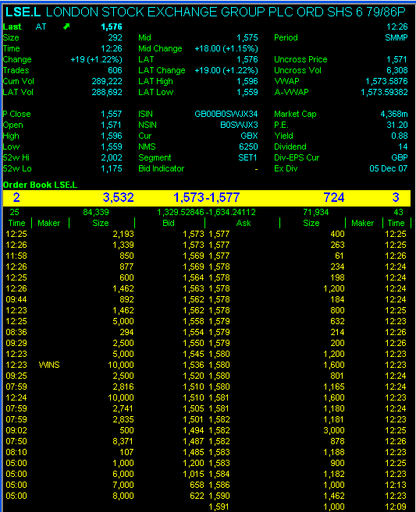
The Great Deceiver- The Central Limit Order Book

Slide 5
The Machines are watching
The Whales
Execution Algorithms
PEG
% of volume
VWAP
TVOL
Slicer
The Sharks
Predatory Algos
Sniper, Piranha, Sigma X

Slide 6
Haim Bodek and Battle of the Quants
High Frequency traders
Quant Driven
Prop trading groups
Grey Box
Securities desks
Derivatives market makers
The CME Order Flow
The Order Identifiers
Where’s the skill?
Front-Running

Slide 7
Is it safe to go back in the water?
Keep to the shallows
Always expect the unexpected
Only way to know what’s in there is to see what comes out
Good Luck and thankyou!

