Slide 1
Directional Changes 2

Slide 2
Concept
Directional Changes are changes on directions
Applied in capital markets, they are changes of prices’ directions
As a time series and a stochastic process, price had and will have only two directions – up and down

Slide 3
Task
Your task becomes find out points, at which the direction of price changes
That is, find out the points at which it changes from a upward trend to a downward trend, or from a downward trend to a upward trend.
However, you are not looking for every directional change, but only under a t% threshold.

Slide 4
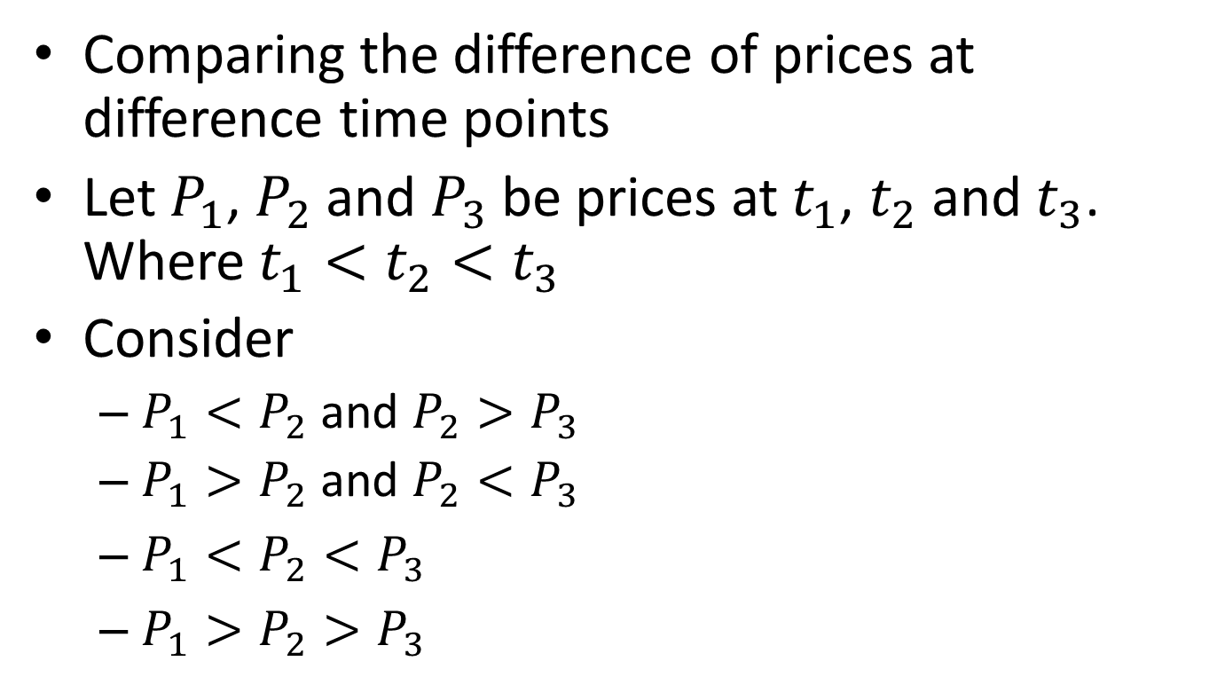
Technique
Comparing the difference of prices at difference time points
Let $P_{1}$, $P_{2}$ and $P_{3}$ be prices at$t_{1}$, $t_{2}$ and $t_{3}$. Where $t_{1}<t_{2}<t_{3}$
Consider
  $P_{1}<P_{2}$ and ${P_{2}>P}_{3}$
  $P_{1}>P_{2}$ and ${P_{2}<P}_{3}$
  $P_{1}<P_{2}<P_{3}$
  $P_{1}>P_{2}>P_{3}$

Slide 5
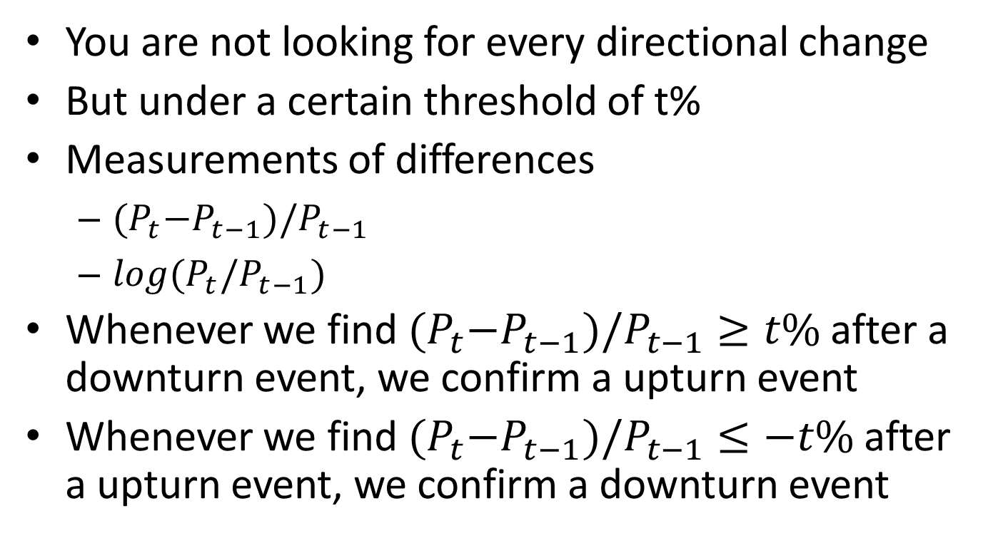
Under the threshold
You are not looking for every directional change
But under a certain threshold of t%
Measurements of differences
  ${(P}_{t}−P_{t−1})/P_{t−1}$
  $log(P_{t}/P_{t−1})$
Whenever we find ${(P}_{t}−P_{t−1})/P_{t−1}≥t\%$ after a downturn event, we confirm a upturn event
Whenever we find ${(P}_{t}−P_{t−1})/P_{t−1}≤−t\%$ after a upturn event, we confirm a downturn event

Slide 6
Code
Code for finding the very first t% change

Slide 7
t=0.05; %Threshold
c=[]; %Space holder for change rates
s=0; %Indicator for former change 0 means a downward run, 1 means an upward run
sign=[]; %Stores all 's'
SD=[]; %Records starting dates
ED=[]; %Records ending dates
i=1;
j=i+1;
%Get the first t%change
while j<=length(p)
change=(p(j)-p(i))/(p(i));
if abs(change)>=t
c=[c change];
SD=[SD i];
ED=[ED j];
%Determine if the price goes up or down
if change>0
s=1;
sign=[sign s];
else if change<0
s=0;
sign=[sign s];
end
end
break
else
j=j+1;
end
end
i=j;

