Slide 1
Directional Changes #3

Slide 2
Importance of Directional Changes
Potentially more profitable
Captures moves of markets better
(Intrinsic time)
A new risk measurement
(Overshoots)
Scaling law
(Trading strategies)

Slide 3
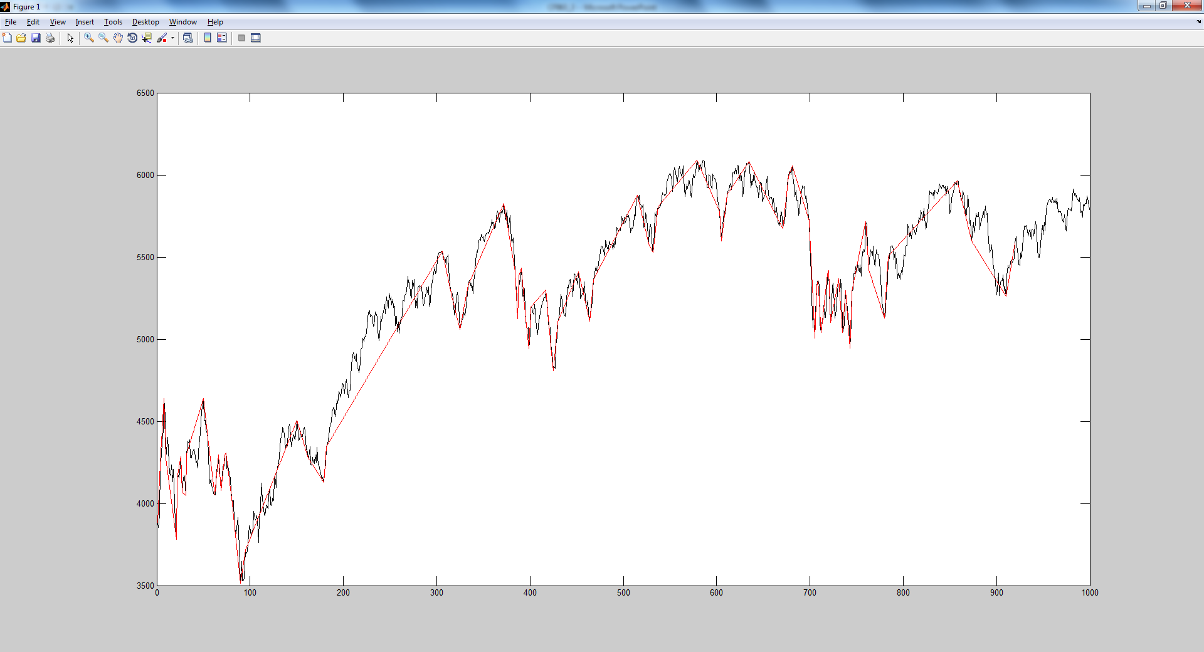
Intrinsic Time
Previously, you have 43 Directional Changes

Slide 4
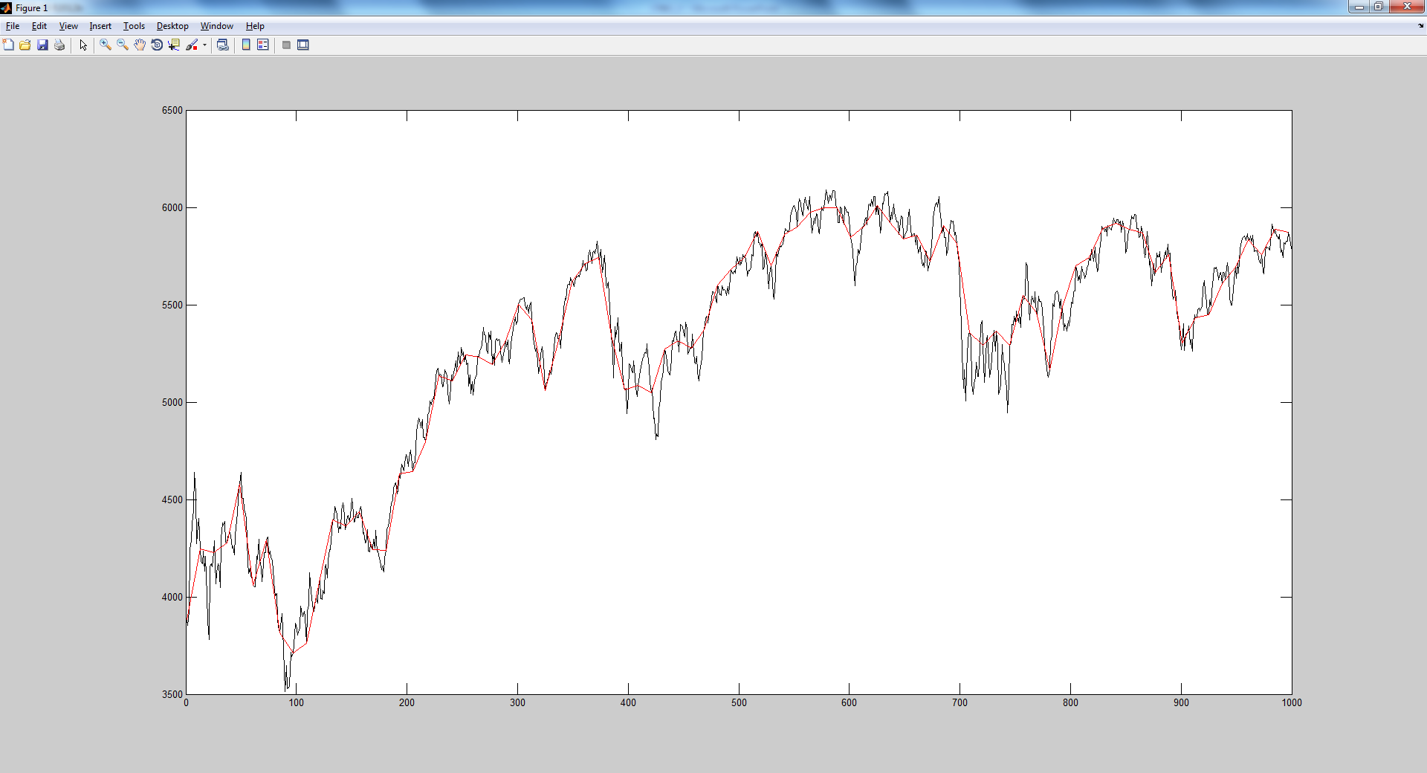
Homogenously divided in to 87 portions

Slide 5
Risk Measurement
Threshold: 5%
Real average threshold: 0.0594
Average Scaling 0.0489
The probability for overshoots to reach
  1 unit of threshold is: 33.33%
  2 units of thresholds is: 9.52%
  3 units of thresholds is: 4.76%
  4 units of thresholds is: 2.38%

Slide 6
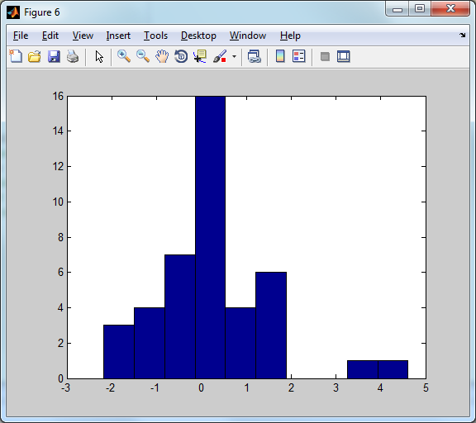
Distribution of overshoots./average_threshold

Slide 7
Trading strategies
Machine Learning
Optimal strategy
Constraint Satisfaction
Hill Climbing
Guide Local Search

Slide 8


Slide 9
Constraint Satisfaction
Any problems can be formulised in following way are CSP, and can be deal with constraint satisfaction techniques:
  Variables (Decisions)
  Domains
  Constraints

Slide 10
Here are three areas: X, Y and Z. Each of them can take Red or Green Colour, but the neighbours can not take the same colour.
Variables
Domains
Constraints
X
Z
Y

Slide 11
Here are three areas: X, Y and Z. Each of them can take Red or Green Colour, but the neighbours can not take the same colour.
Variables: X, Y, Z
Domains: {Red, Green}
Constraints:
X ≠ Y, Y ≠ Z, Z ≠ X
X
Z
Y

Slide 12
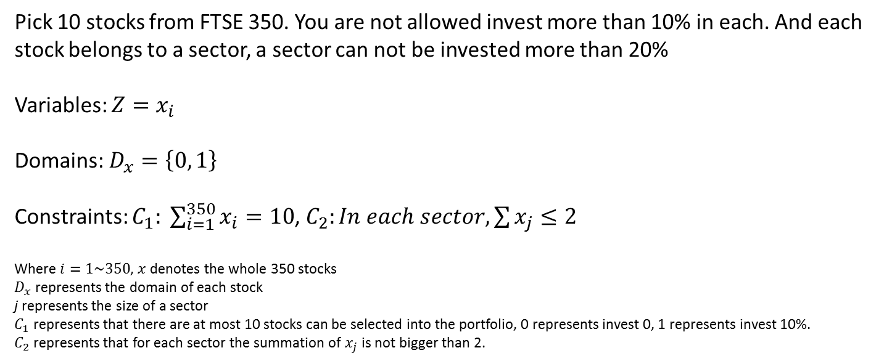
An example
Pick 10 stocks from FTSE 350. You are not allowed invest more than 10% in each. And each stock belongs to a sector, a sector can not be invested more than 20%
Variables: $Z=x_{i}$
Domains: $D_{x}=\left\{0, 1\right\}$
Constraints: $C_{1}: \sum_{i=1}^{350}{x_{i}=10}$, $C_{2}:In each sector, \sum{x_{j}}≤2$
Where $i=1\sim 350$, $x$ denotes the whole 350 stocks
$D_{x}$ represents the domain of each stock
j represents the size of a sector
$C_{1}$ represents that there are at most 10 stocks can be selected into the portfolio, 0 represents invest 0, 1 represents invest 10%.
$C_{2}$ represents that for each sector the summation of $x_{j}$ is not bigger than 2.

Slide 13

Formalisation of Finding Trading Strategies
Variables: $Z=x_{i}\left(t_{i},a_{i},P_{i}\right)$
Domains:
  $t∈anytime$
  $a∈\left[0,1\right]$
  $P∈\left\{−1,1\right\}$
Constraints:
  $t∈{(t}_{j},t_{j+1}]$

Slide 14
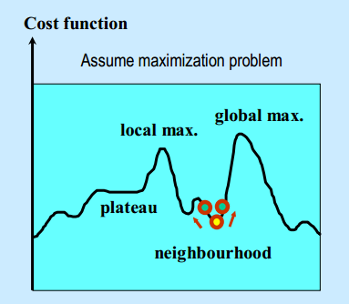
Hill Climbing
Problems:
Local optimal
Plateau
No guarantee finding the best solution

Slide 15
Step 1
Random assignment
Evaluate by a Cost/Performance function
Step 2
Observe the environment
Move to next better point according to Neighbourhood function
Step 3
Start over from step 2
Stop when no better solutions can be found or certain criteria reached

Slide 16
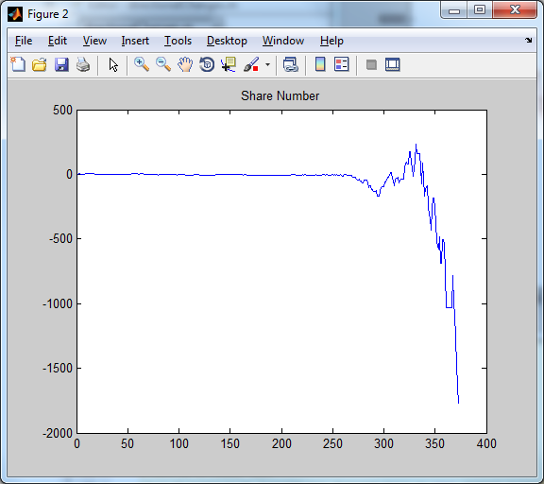
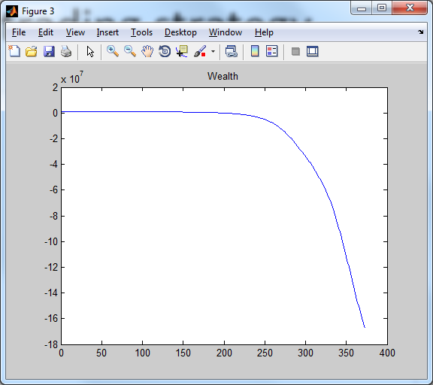
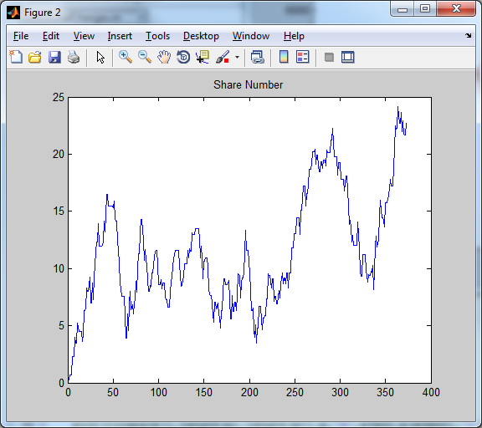
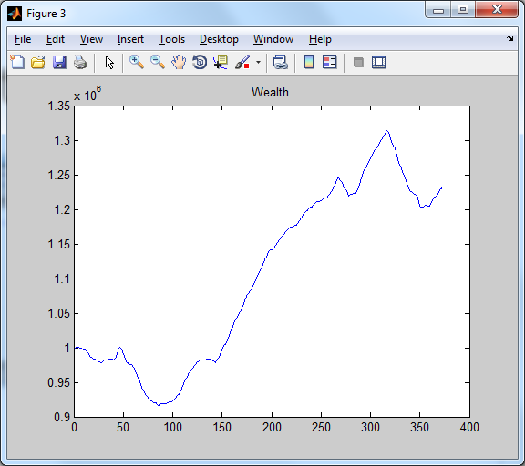
A random trading strategy
What do you do?
When do you do?
How do you do?

