Slide 1
Screening, Scoring & Ethical (Islamic) Screening.
Bob Berry
Nottingham University Business School

Slide 2
1950s - The “Golden” Decade for Finance?????
Markowitz, H. (1952) “Portfolio Selection” Journal of Finance, 7(March), pp77-91.
Max U = E(R_{P}) – 0.5Avar(R_{P})
s.t.
E(R_{P}) = x^{T}µ
var(R_{P})= x^{T} Ωx
x^{T}1=1
x≥0

Slide 3
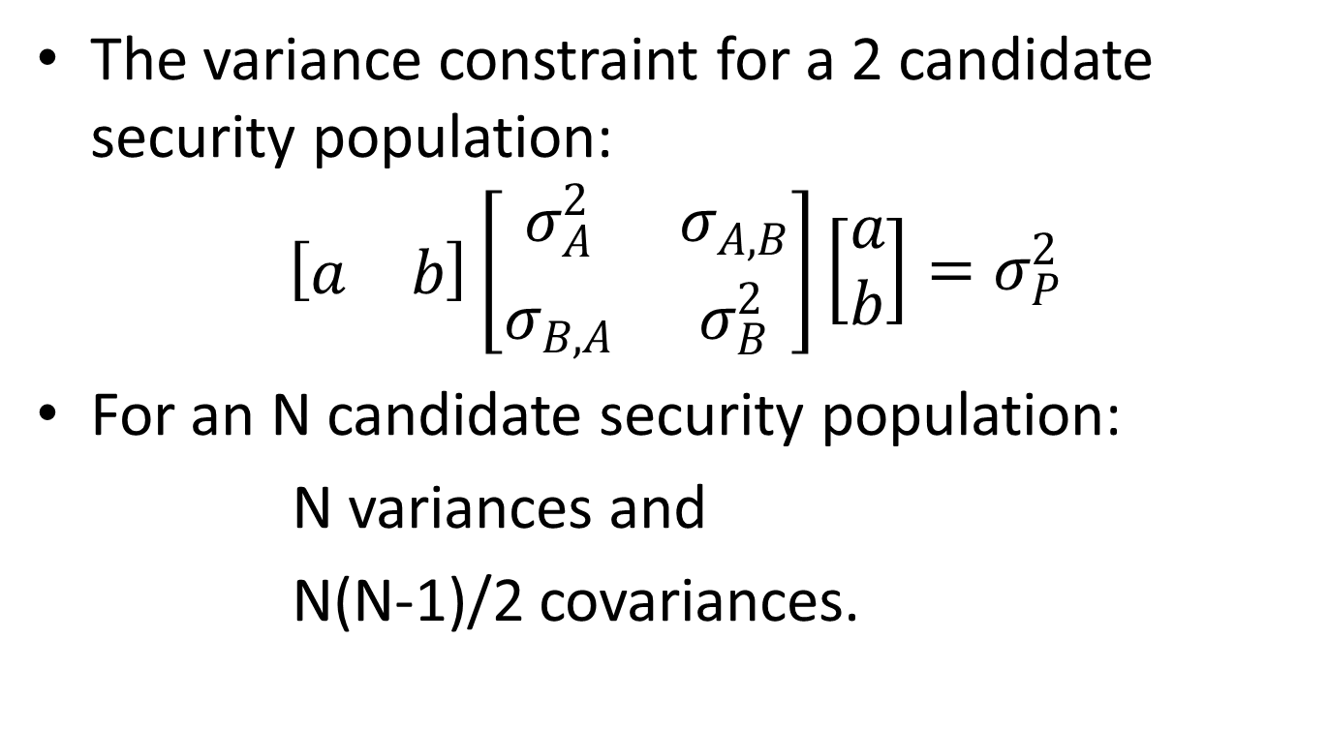
The problem.
The variance constraint for a 2 candidate security population:
$$\left[\begin{matrix}a & b\end{matrix}\right]\left[\begin{matrix}σ_{A}^{2} & σ_{A,B} \\ σ_{B,A} & σ_{B}^{2}\end{matrix}\right]\left[\begin{matrix}a \\ b\end{matrix}\right]=σ_{P}^{2}$$
For an N candidate security population:
N variances and
N(N-1)/2 covariances.

Slide 4
“The” solution.
Sharpe, W. F. (1963) “A Simplified Model For Portfolio Analysis”, Management Science, 10(January), pp277-293.
Co-movements in security returns arise from a common force that affects the performance of all firms, the state of the economy (e.g. return on a stock market index).
For an N candidate security population:
σ_{j}² = β_{j}² σ_{m}² + σ_{uj}² ( need one σ_{m} )
σ_{jk} =β_{j}β_{k}σ_{m}² ( need N β_{j} )

Slide 5
The implications.
We can maintain a large population of candidate securities because we need only two parameters for each of them, mean return and Beta.
Invoking the assumption of stationarity turns the production of a variance covariance matrix into an estimation (rather than a forecasting) problem.

Slide 6
An alternative solution.
Recognize that there are some securities you won’t touch with a bargepole!
Throw them away!
Concentrate effort on understanding potential future returns of securities that are genuine candidates for inclusion in your portfolio.
In other words SCREEN.

Slide 7
Screening.
A criterion (screen) is selected to define potentially acceptable companies (securities) e.g. companies which have an interest to profit ratio of less than 30%.
Analyse further only those securities which pass the test.
Multiple screens can be used, one after the other, before any consideration is given to the future behaviour of returns.
(Some screens can of course become constraints in a mathematical programming model, but applied in this way don’t limit the data collection exercise. )

Slide 8
Alternative approaches to screening.
Screens take 3 basic forms:
Negative screening. The idea here is to exclude candidate securities (companies).
Positive screening. This is a search for acceptable candidate securities.
Best in class. The best might not be good, but it is the best! (This approach potentially maintains diversification possibilities.)

Slide 9
Using multiple screens.
The order of application of screens won’t affect the final list of securities selected.
Therefore order screens to minimise the overall cost of screening.
Screens using easily available data should come first.
Where data has to be collected specifically, and hence expensively, screen on that criterion last.

Slide 10
Common screens.
“The PE ratio, the dividend yield, the stock price, and the 5 week trading range are common screening criteria.”
Strong, R. A. Portfolio Construction, Management, and Protection 4th ed, Thomson South-Western, 2006.

Slide 11
On line screening tools.
There are many screening tools available on the web.
Key aspects are:
Composition and size of the database of companies?
Variables available for use in screens?
Ease of building a customised set of screens?
Thorp, W. A. (2010) “The Top Web-Based Stock Screening Services” Computerized Investing, XXIX(3), pp22-29. (look at www.computerizedinvesting.com)

Slide 12
Scoring.
In a scoring system, different measures are given weights, and a sum of weighted measures is calculated.
In a scoring system, no matter how badly a company performs on one criterion, it may still feature in the final subset of companies because it performs well on another criterion.
A screen based on the final score may then be used. This is effectively a cut off point.

Slide 13
A scoring example (1).
One example is a Greenblatt screen, actually a scoring system. (Investors Chronicle, 28 Jan – 3 Feb, 2011, p50).
The Greenblatt screen is based on the following ratios:
EY = EBIT (earnings before interest and tax) as a percentage of EV (enterprise value = market value of equity + debt – cash).
ROC = EBIT as a percentage of tangible assets employed (current assets less cash, less other current liabilities, less interest bearing short term debt, plus net fixed assets).

Slide 14
A scoring example (2).
According to the Investors Chronicle:
EY measures the “cheapness” of the share.
ROC (alternatively ROA) measures the “quality of the business”.
Shares are ranked on each criterion.
The rankings are then added together and the shares with the highest combined ranking are selected (an equal weight scoring system).

Slide 15
A scoring example (3).
BHP Billiton had the highest score (138), while Education Development International had the lowest (19).
Healthcare Locums had a score of 90, BUT “Healthcare Locums shares have subsequently been suspended following the discovery of accounting irregularities…” (Investors Chronicle).
Remember screens and scores are only as good as the data (published accounts) they are based on.

Slide 16
A scoring example (4).
The Investors Chronicle screened on Greenblatt and a size screen (>£50m equity value) to select 30 shares.
Unanswered questions:
How often should selection process be carried out?
How should the 30 securities be combined? (Markowitz again!)

Slide 17
Ethical screening,
Many current discussions of screening concentrate on forms of ethical screening (religious grounds, on “green” or “social” grounds etc.)
BUT not all ethical screens are aimed at excluding “ethically bad” companies. “sin stocks” could be a high return portfolio [Fabozzi, F. J., Ma, K. C. & Oliphat, B. J.(2008) “Sin Stock Returns” Journal of Portfolio Management, 35(1), pp82-94.]
Also be aware of “Engagement directed” screening as a possible fourth type of screening. (Think of this as worst in class.)

Slide 18
One ethical approach: Islamic Investment
The easiest way to offend people is to appear to take their religion lightly. I’m attempting in what follows to interpret the teachings of a religion which is not my own. If I misinterpret what Islam teaches, then please forgive me and tell me where I am wrong.

Slide 19
The Significance of Islam in the World.
Roughly 20% of the world’s population are Muslims.
They are poorly served by the typically westernised financial systems they live within.
Islam is a global not merely a Middle Eastern religion.
Think of Indonesia and Malaysia.
(The US has a Muslim population of about 4.6 million, for example.)
Islam can mean different things to different people.

Slide 20
Sharia Law
Islam is concerned with everyday conduct.
Sharia, “a clear path to be followed and observed”
Sharia Law is derived from four sources:
  the Quran, God’s message to Mohammed (20 verses);
  Sunna, the living tradition of Mohammed;
  Ijma which is the current consensus;
  Qiyas which is reasoning by analogy. (possibility of disagreement.)
  Ijtihada which is reasoning by an Islamic scholar about new cases. (possibility of disagreement.)

Slide 21
Can shares be traded? (1)
A limited liability ownership claim.
A musharakah contract – ownership rights to the value of assets.
BUT:
What if a company owns only liquid assets?
What about margin accounts?
Is speculation really gambling?
Short selling something you don’t own.

Slide 22
Can shares be traded? (2)
What about preference shares? Too much like debt?
Is high frequency trading too much like gambling? Saw, S-H, & Wang, K. Introduction to Islamic Finance, Saw centre for Financial Studies, 2008.
In practice most Islamic scholars see share holding and trading as acceptable activities.

Slide 23
Islamic screens.
An Islamic investor will avoid:
firms engaging in activities which are “haram” e.g. gambling and alcohol.
firms with a high level of debt in the capital structure or a high level of interest in the revenue stream (avoidance of “riba”).
The concept of “gharar” is also potentially relevant excessive risk, concealment of information, unfairness). Firms with opaque business models or financial reports might well be avoided.
Derigs, U. & Marzban, S. (2008) “Review and Analysis of Current Shariah-Compliant Equity Screening Practices” International Journal of Islamic and Middle Eastern Finance and Management, 1(4), pp285-303.

Slide 24
Islamic investors face problems.
Islamic screens need more than company financials. Amiri Capital uses “Amiri S³”. This screens first against excessive debt, and then against a company’s activities (gambling etc).
Compromise may be necessary:
Some Islamic investors adopt weaker criteria than others e.g. less than 30% interest, rather than zero interest.
There may be a place for best in class.
Some investors will “purify” their investments by making compensating charitable donations.

Slide 25
Ethical funds and Islamic funds.
Ethical investors have access to funds which screen on their behalf. On 23/9/’14 YourEthicalMoney.org produced a list of 68 ethical investment funds and ISAs.
HSBC Amanah Global Equity Index Fund is an Islamic fund. Haram activities screened against are: Alcohol, Gambling, Armaments, Tobacco, Pornography. This is the only fund among the 68 specifically stated to be Shariah compliant.
Ethical and Islamic indices also exist. They are also screen based systems e.g. FTSE4Good, Dow Jones Islamic Market Indices. (Screens often become more stringent over time and put pressure on companies to improve ethical performance to maintain their presence in the index.)
Performance of ethical and Islamic portfolios can be compared to that of relevant indices.

Slide 26
Example Company Analysis (1)
AIF Investor Services rates companies with respect to Sharia (Shari’ah) compliance.
An AIF ranking can be summarised by a three figure code e.g. A1b.
The first letter identifies the extent to which the company avoids prohibited revenues. There are five levels, A, B, C, D, and F.

Slide 27
Example Company Analysis (2)
The second character, the number, reflects the extent to which riba is avoided. There are five levels, 1, 2, 3, 4, and 5.
The third character, the lower case letter, reflects avoidance of excessive ambiguity and conformance with the laws of the land. There are three levels, a, b, and c.
A forecast score is also provided acknowledging the possibility of change.

Slide 28
Ethical/Islamic investors.
The use of the phrases “ethical investor” and “Islamic investors” send a signal of uniformity. However different ethical investors may have different ethical concerns. Also investors with many different motives invest in ethical securities:
Traditional investors who concentrate on the trade-off between financial risk and return may take the view that the “Green” consumer movement will ensure strong financial performance for firms pursuing ethical approaches.
Berry, R. H. & Yeung, F. (2013) “Are Investors Willing to Sacrifice Cash for Morality” Journal of Business Ethics, 117, pp 477-492

Slide 29
Current (& future) research
It is unusual for ethical screening to include a consideration of variability of ethical performance. Financial risk is analysed, so why not ethical risk?
(Berry, R. H. & Yeung, F. (2015) “Ethical Risk & Ethical Investors”, Working Paper available from the authors.)
Does diversification work for ethical investors?
Ethical screens are usually “crisp”! Perhaps they should be “fuzzy”.

