Slide 1
Ethical Risk and Ethical Investors
Bob Berry (Nottingham)
&
Fannie Yeung (Hull)

Slide 2
What is ethical risk here?
Variability of a measure of a firm’s ethical performance over time (time series).
(Not) Variability of a measure of firms’ ethical performance across firms (cross section).
(Not) Impact of ethical performance of a firm on the financial performance of its shares.

Slide 3
How can we identify ethical investors?
We can’t see inside people’s heads.
We could try to induce an ‘ethical’ mind set, but …. (Glac, 2009).
We can identify the portfolios people hold.
So ethical investors are defined for the purposes of this research (and widely) as investors who hold ethical portfolios.

Slide 4
What prompted the research?
The evidence for ethical risk is everywhere.
(But) the practice of ethical screening implies that current ethical performance will continue over the life of an investment. Ethicality is a binary variable!
Academic study treats financial performance and ethical performance differently. Compare Markowitz (1952) with Hallerbach et. al., (2004) and Beal et. al., (2005).

Slide 5
VW
Annual Report 2012 says “one of only three automobile companies listed in the Dow Jones Sustainability Index, …” (actually several DJS indices, and by 2015 six automobile companies.)
Press release (29/9/’15) from index organisers Robeco Sam and S&P, “Volkswagen will be removed from the Dow Jones Sustainability Indices as of October 6th 2015.”
In fact In=(1999-2004) and (2007-2015).

Slide 6
What questions does the research aim to answer?
Is variability of ethical performance ignored in practice and theory because ethical investors don’t care about it or because they aren’t aware of it?
If ethical investors are made aware of ethical risk do they change their investment behaviour?
How important is ethical risk?
Are downside and upside risk equally important?

Slide 7
Setting up the study.
Questionnaire sent to investors in an ethical fund.
Contained paired, stylised descriptions of companies’ circumstances highlighting ethical risk differences.
Asks what fraction of a £100k portfolio would investors assign to these companies.
192 investors returned 102 partially or fully completed questionnaires.
80 fully completed for the purposes of this paper.

Slide 8
Companies’ circumstances.
 | Financial Level | Ethical Level | Ethical Risk
X | Good | Good | Upside
F | Good | Good | None
H | Good | Good | Downside
A/J | Good | Poor | Upside
G | Good | Poor | None
D | Good | Poor | Downside
X | Poor | Good | Upside
B | Poor | Good | None
E | Poor | Good | Downside
C | Poor | Poor | Upside
I | Poor | Poor | None
X | Poor | Poor | Downside

Slide 9
Ethical risk related comments.
Investment | Ethical Risk Related Text
F | Current ethical performance is guaranteed to continue.
H | The ability of a new production unit to meet current ethical standards is unpredictable.
A | Due to a recent consumer boycott against the company’s unethical behaviour, a social responsibility officer has been appointed to assess the need for change.
J | The company has begun incorporating the concerns of ethical investors into its business policies.
G | No change in ethical performance is expected.
D | The management has openly dismissed the importance of ethical behaviour to its operations.
B | Continuation of current ethical performance is guaranteed.
E | The company has routinely contravened its ethical policies in the past.
C | The company has recently been taken over by a conglomerate with an excellent social responsibility record.
I | Ethical performance is expected to remain the same.

Slide 10
Data & Analysis
For each of 80 respondents we have % invested in 10 (8+2) companies.
% transformed into ranks 1,2,3,4,5, with 5 representing the largest investment level.
Analysed
To compare levels of investment in matched pairs of companies using variants of ANOVA and “t tests”.
To identify importance of ethical risk relative to levels of ethical and financial performance using conjoint analysis.

Slide 11
Do investors respond to ethical risk? (1)
Does repeated measures ANOVA show that average investment levels vary significantly between companies? Calculated F=199.2 compared to critical value 2.026. Significant far below the 1% level.
This result justifies consideration of planned pairwise comparisons. (Jumping straight into paired t tests implies P {at least one significant pair by chance} of approx 76%).
Many ways of doing pairwise comparisons, but If the message in the data is clear the choice of test shouldn’t make a difference.

Slide 12
Do investors respond to ethical risk? (2)
Pair | Financial Level | Ethical Level | Ethical Risk | No Diff Response | Consistent With Expectation | Not Consistent with Expectation | Hypothesis Test Result | P value
F>H | G | G | N>D | 22 | 58 | 0 | Reject Null | <0.0001
B>E | P | G | N>D | 20 | 59 | 1 | Reject Null | <0.0001
G>D | G | P | N>D | 59 | 17 | 4 | Reject Null | 0.0036
A>G | G | P | U>N | 35 | 44 | 1 | Reject Null | <0.0001
C>I | P | P | U>N | 43 | 34 | 3 | Reject Null | <0.0001
J>A | G | P | Uj>Ua | 27 | 45 | 8 | Reject Null | <0.0001

Slide 13
Response to risk.
H0: Mean difference zero v H1: Mean difference >0. No difference is generally strongly rejected.
The G>D comparison result is the “weakest”, but remains significant at the 1% level in all alternative tests. (Fin=G, E=P, ER= No Change v Downside).
Ties represent investors not responding to a specific risk comparison.
There are some ‘mistakes’ – i.e. not consistent with direction predictions.
Given 6 opportunities to respond to ethical risk differences, on average investors responded on 3.43 occasions.

Slide 14
How important is ethical risk? (1)
Conjoint analysis involves 80 individual regressions each with 8 observations.
I_{j} = b₀ + b₁GF_{j} + b₂GE_{j} + b₃UER_{j} + b₄DER_{j} + e_{j}
j identifies the particular investment opportunity
I_{j} the “utility” derived by the individual from investment opportunity j (as indicated by investment level).
GF_{j} a dummy variable indicating presence (1) or absence (0) of the characteristic “good financial performance” in investment opportunity j.
GE_{j} a dummy variable indicating presence (1) or absence (0) of the characteristic “good ethical performance” in investment opportunity j.
UER_{j} a dummy variable indicating presence (1) or absence (0) of the characteristic “upside ethical risk” in investment opportunity j.
DER_{j} a dummy variable indicating presence (1) or absence (0) of the characteristic “downside ethical risk” in investment opportunity j.
b_{K} the coefficient indicating the addition to the utility of the individual caused by the presence of a particular investment characteristic (e.g. UER)
b₀ the coefficient indicating the utility which the individual derives from the base case investment involving poor ethical and financial performance and an absence of ethical risk.

Slide 15
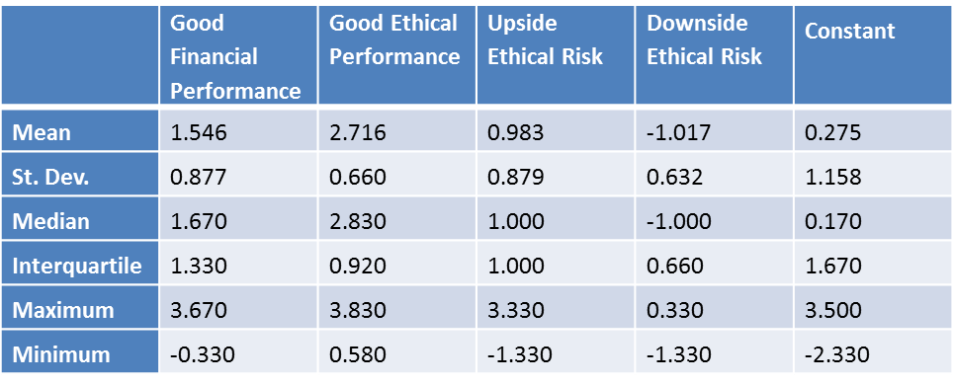
How important is ethical risk? (2)
The parameters for the coefficients’ distributions are:
Notes:
Conjoint coefficients average over 80 investors.

Slide 16
How important is ethical risk? (3)
To assess the relative importance of attributes Hair et. al. (1998) suggest expressing low to high “part worths” as % of the sum of these differences.
“This allows for comparison across respondents on a common scale.”

Slide 17
How important is ethical risk? (4)
Relative importance of ethical risk, level of ethical performance, level of financial performance:

Slide 18
Comments on relative importance.
Differences in means exist! Therefore pairwise comparisons can be made.
Level of ethical performance has more impact than ethical risk, which in turn has more impact than level of financial performance.
Upside and downside ethical risk approximately equal in importance.
Attitude to ethical risk does not vary according to type of ethical investor (see JBusEth Paper.)

Slide 19
Questions (from me to you).
Where are the problems?
Measurement of relative importance?
Importance of results?

