Slide 1
EDDIE for Financial Forecasting
Michael Kampouridis
m.kampouridis@kent.ac.uk

Slide 2
Contents of today's talk
Forecasting
Financial forecasting
  What is it?
  Is it possible?
  Methods
Computational Intelligence for financial forecasting
EDDIE for financial forecasting
  How it works
  Research on EDDIE 7 and EDDIE 8
  Latest research

Slide 3
Contents of today's talk
Forecasting
Financial forecasting
  What is it?
  Is it possible?
  Methods
Computational Intelligence for financial forecasting
EDDIE for financial forecasting
  How it works
  Research on EDDIE 7 and EDDIE 8
  Latest research

Slide 4
Forecasting in general
“Forecasting is the process of making statements about events whose actual outcomes (typically) have not yet been observed” – Wikipedia
Weather forecasting
Business new product/service success forecasting
Financial forecasting
Other

Slide 5
Contents of today's talk
Forecasting
Financial forecasting
  What is it?
  Is it possible?
  Methods
Computational Intelligence for financial forecasting
EDDIE for financial forecasting
  How it works
  Research on EDDIE 7 and EDDIE 8
  Latest research

Slide 6
Financial Forecasting
Forecast price movement of stock/market
Forecast opportunities (buy, not-buy, sell, arbitrage)
Forecast threats
  Forecast scarce opportunities

Slide 7
Data used for forecasting
Daily (daily closing prices)
Intraday (high frequency)
Volume
Indices
Economic models

Slide 8
Contents of today's talk
Forecasting
Financial forecasting
  What is it?
  Is it possible?
  Methods
Computational Intelligence for financial forecasting
EDDIE for financial forecasting
  How it works
  Research on EDDIE 7 and EDDIE 8
  Latest research

Slide 9
Is it possible?
Lots of debates!
Efficient Market Hypothesis (EMH)
  Prices fully reflect the available information that relates to the financial asset being traded
  If EMH holds, then no point of forecasting
  Lot of works examining the EMH from both theoretical and empirical perspective
    Evidence both in favor of and against EMH
“Successful” financial forecasting attempts
  FX market, bond market, volatility forecasting, stock market crash, …

Slide 10
Contents of today's talk
Forecasting
Financial forecasting
  What is it?
  Is it possible?
  Methods
Computational Intelligence for financial forecasting
EDDIE for financial forecasting
  How it works
  Research on EDDIE 7 and EDDIE 8
  Latest research

Slide 11
Methods
Fundamental analysis
  Examine a company’s financial statements and balance sheets in order to predict future trends of their shares
  Depends on statistics, past records of assets, earnings, dividends, interest rates, sales, products, management, markets
Technical analysis
  Use historical data in order to predict future events
  Belief that there are patterns in the stock prices and that these patterns repeat themselves
  Technical indicators
    Moving Average, Filter, Trade Break Out, Momentum, Momentum Moving Average

Slide 12
Contents of today's talk
Forecasting
Financial forecasting
  What is it?
  Is it possible?
  Methods
Computational Intelligence for financial forecasting
EDDIE for financial forecasting
  How it works
  Research on EDDIE 7 and EDDIE 8
  Latest research

Slide 13
Computational Intelligence for financial forecasting
Artificial Neural Networks
Genetic Algorithms
Genetic Programming
Grammatical Evolution
Support Vector Machines
Learning Classifier Systems
Genetic Network Programming
Differential Evolution

Slide 14
Computational Intelligence for financial forecasting
Artificial Neural Networks
Genetic Algorithms
Genetic Programming
Grammatical Evolution
Support Vector Machines
Learning Classifier Systems
Genetic Network Programming
Differential Evolution

Slide 15
Genetic Programming
Initialise random population of individuals/trees (in our case trading strategies)
Evaluate each tree and assign fitness
Select trees in order to produce new offspring by the use of different operators (e.g. crossover, mutation)
Repeat the previous two step for a number of times (“generations”)

Slide 16
Financial Forecasting
Using EDDIE
Functions
Terminals
Sample GDT
If-then-else
<
Buy (1)
If-then-else
12 days Moving Average
6.4
>
Not Buy (0)
Buy (1)
50 days Momentum
5.57

Slide 17
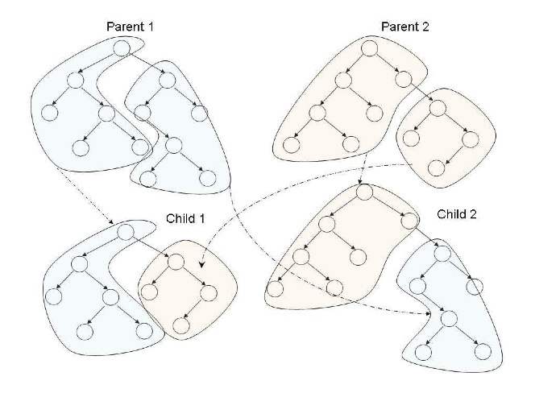
Crossover operator

Slide 18
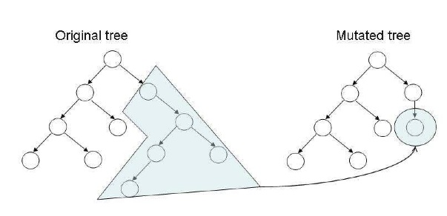
Mutation operator

Slide 19
Contents of today's talk
Forecasting
Financial forecasting
  What is it?
  Is it possible?
  Methods
Computational Intelligence for financial forecasting
EDDIE for financial forecasting
  How it works
  Research on EDDIE 7 and EDDIE 8
  Latest research

Slide 20
EDDIE’s goal
EDDIE is a GP tool that attempts to answer the following question:
  “Will the price of the X stock go up by r% within the next n days”?
  Users specify X, r, and n

Slide 21
How EDDIE works
Training Data
1. Suggestion
of indicators
Financial Expert
EDDIE
5. Approval / rejection
Testing Data
4. Apply
2. Output
Training Data
Genetic Decision Tree
(GDT)
3. Evaluate

Slide 22
How the training data is created
Given
Daily closing
90
99
87
82
…..
Expert adds:
50 days M.A.
80
82
83
82
…..
More input:
12 days Vol
50
52
53
51
…..
…..
Define target:
↑4% in 20 days?
1
0
1
1
…..

Slide 23
EDDIE 8: Technical Indicators
Technical Indicator (Abbreviation)
Moving Average (MA)
Trade Break Out (TBR)
Filter (FLR)
Volatility (Vol)
Momentum (Mom)
Momentum Moving Average (MomMA)

Slide 24
Financial Forecasting
Using EDDIE
Functions
Terminals
Sample GDT
If-then-else
<
Buy (1)
If-then-else
12 days Moving Average
6.4
>
Not Buy (0)
Buy (1)
50 days Momentum
5.57

Slide 25
Genetic Programming
Initialise random population of individuals/trees (in our case trading strategies)
Evaluate each tree and assign fitness
Select trees in order to produce new offspring by the use of different operators (e.g. crossover, mutation)
Repeat the previous two step for a number of times (“generations”)

Slide 26
Genetic Programming
Initialise random population of individuals/trees (in our case trading strategies)
Evaluate each tree and assign fitness
Select trees in order to produce new offspring by the use of different operators (e.g. crossover, mutation)
Repeat the previous two step for a number of times (“generations”)

Slide 27
Performance Measures
Predictions
Reality
Negative
Positive
Negative
True Negative
False Negative
Positive
False Positive
True Positive
Rate of Correctness (RC) = (TN + TP) ÷ Total
Rate of Failure (RF) = FP ÷ (FP + TP)
Rate of Missing Chances (RMC) = FN ÷ (FN+TP)
Fitness Function (ff) = w1*RC-w2*RMC-w3*RF

Slide 28
Constraints in the Fitness Function
ff = w1’*RC-w2*RMC-w3*RF
Constraint R = [Cmin, Cmax]
  where Cmin = (Pmin/Ntr) x 100%,Cmax = (Pmax/Ntr) x 100%, 0<= Cmin <= Cmax <= 100%
  Ntr is the total number of training data cases
  Pmin is the minimum number of positive predictions required
  Pmax is the maximum number of positive predictions required
If the percentage of positive signals predicted falls in the range of constraint R, then w1’ = w1. If not, then w1’ = 0.
In the latter case, the GDT is heavily penalized and ends up with a negative fitness function

Slide 29
Example
Assume I have a trading strategy/tree:
  If
  MA_12 < 81
  Then
  Buy (1)
  Else
  Not-Buy (0)
12 days Moving Average | Target (Reality) | Prediction | Classification
80 | 0 | 0 | TN
82 | 1 | 1 | TP
79 | 1 | 0 | FN
83 | 0 | 1 | FP

Slide 30
Example
 | Fitness | Rate of Correctness (RC) | Rate of Missing Chances (RMC) | Rate of Failure (RF)
Tree 1 | 0.24 | 0.62 | 0.30 | 0.33
Tree 2 | 0.235 | 0.61 | 0.41 | 0.30
Tree 3 | 0.26 | 0.65 | 0.25 | 0.35
Tree 4 | 0.05 | 0.50 | 0.70 | 0.60
Tree 5 | 0.42 | 0.75 | 0.15 | 0.05
Average | 0.24 | 0.626 | 0.362 | 0.326
Standard Deviation | 0.13 | 0.08 | 0.21 | 0.195
Max | 0.42 | 0.75 | 0.7 | 0.6
Min | 0.05 | 0.5 | 0.15 | 0.05

Slide 31
Contents of today's talk
Forecasting
Financial forecasting
  What is it?
  Is it possible?
  Methods
Computational Intelligence for financial forecasting
EDDIE for financial forecasting
  How it works
  Research on EDDIE 7 and EDDIE 8
  Latest research

Slide 32
Financial Forecasting
Using EDDIE
Functions
Terminals
EDDIE 7 Sample GDT
If-then-else
<
Buy (1)
If-then-else
12 days Moving Average
6.4
>
Not Buy (0)
Buy (1)
50 days Momentum
5.57

Slide 33
Financial Forecasting
Using EDDIE
Functions
Terminals
EDDIE 8 Sample GDT
If-then-else
<
Buy (1)
If-then-else
VarConstructor
6.4
>
Not Buy (0)
Buy (1)
Moving Average
12
VarConstructor
5.57
Momentum
50

Slide 34
Research agenda for EDDIE 7 and EDDIE 8
Why use technical indicators with pre-specified period length? (e.g. 12 Moving Average)
Investigate if prediction performance (i.e. fitness) can be improved by allowing the GP to look for the optimal period length
Allow any length between a parameterised range, e.g. 2-65 days

Slide 35
Research results on EDDIE 7 vs EDDIE 8
EDDIE 8 was able to search in the extended search space and discover new, better solutions that EDDIE 7 could not
EDDIE 8 could not always outperform EDDIE 7
  Trade-off between ‘searching in a bigger space’ and ‘search effectiveness’

Slide 36
Further Discussion
Results are affected by the patterns in the datasets
  If results come from EDDIE 8’s search space, then EDDIE 8 is able to outperform EDDIE 7
  If results come from EDDIE 7’s search space, then EDDIE 8 is having difficulties in finding as good solutions as EDDIE 7 does
  Solutions are still in EDDIE 8’s search space, but they come from a very small area of it (EDDIE 7’s space), and thus it is very hard for EDDIE 8 to search effectively in such a small space

Slide 37
A look at search spaces…
            MA
TRB
FLR
Vol
EDDIE 8
Mom
MomMA
62
2
3
4
5
27
15
45
6
46
12
14
16
46
25
EDDIE 7
37
39
7
17
64
26
38
9
13
54
50
44
61
8
11
EDDIE 7
51
10
32
31

Slide 38
Contents of today's talk
Forecasting
Financial forecasting
  What is it?
  Is it possible?
  Methods
Computational Intelligence for financial forecasting
EDDIE for financial forecasting
  How it works
  Research on EDDIE 7 and EDDIE 8
  Latest research

Slide 39
Meta-heuristics and hyper-heuristics for EDDIE
Use different meta-heuristics to search in the space of the technical indicators and their periods
  Hill climbing, Simulated Annealing, Tabu Search, Guided Local Search, …..
  Use EDDIE 8 with any of the above meta-heuristics
Combine successful meta-heuristics into different frameworks: hyper-heuristics

Slide 40
Meta-heuristics and hyper-heuristics for EDDIE
Use different meta-heuristics to search in the space of the technical indicators and their periods
  Hill climbing, Simulated Annealing, Tabu Search, Guided Local Search, …..
  Use EDDIE 8 with any of the above meta-heuristics
Combine successful meta-heuristics into different frameworks: hyper-heuristics

Slide 41
Heuristics
Example of Iterative Hill Climbing
If-then-else
<
Buy (1)
Not Buy (0)
Original GDT fitness = 0.22
VarConstructor
6.4
Fitness under Period=13: 0.23
Fitness under Period=14: 0.24
14
Moving Average
12
13
Fitness under Period=15: 0.22
14
15
Hill Climbing terminates.
New period stored in GDT=14
Hill Climbing for 3 periods

Slide 42
Example
Constraint : period [2, 65]
If-then-else
<
Buy (1)
Not Buy (0)
Original GDT fitness = 0.22
VarConstructor
6.4
Fitness after first iteration = 0.23
New period accepted
Moving Average
12
14
13
13
14
Fitness after second iteration = 0.21
New period rejected. Quit SA. Period to return is

Slide 43
Simulated Annealing
Significantly improved: 27 Significantly worsened: 7
Dataset | Heuristic | Fitness | RC | RMC | RF
Barclays | Original | 0.3633 | 0.7100 | 0.2449 | 0.0411
 | S.A. | 0.4350 | 0.8167 | 0 | 0.0541
BAT | Original | 0.3303 | 0.6667 | 0.2780 | 0.1083
 | S.A | 0.3690 | 0.7433 | 0 | 0
Cadbury | Original | 0.3685 | 0.7533 | 0.1341 | 0.2131
 | S.A. | 0.3733 | 0.7600 | 0 | 0.2179
Imp Tob | Original | 0.2802 | 0.6367 | 0.3946 | 0
 | S.A. | 0.2929 | 0.6533 | 0 | 0
Schroders | Original | 0.2369 | 0.6100 | 0.2333 | 0.2456
 | S.A | 0.3054 | 0.6800 | 0 | 0.1780
Sky | Original | 0.2066 | 0.6800 | 0.5922 | 0.4222
 | S.A. | 0.3059 | 0.6967 | 0 | 0
Sample BEST Results for SA
BETTER WORSE

Slide 44
Tabu Search
Significantly improved: 31 Significantly worsened: 4
Dataset | Heuristic | Fitness | RC | RMC | RF
Barclays | Original | 0.3633 | 0.7100 | 0.2449 | 0.0411
 | T.S. | 0.4350 | 0.8167 | 0 | 0.0392
BAT | Original | 0.3303 | 0.6667 | 0.2780 | 0.1083
 | T.S. | 0.3323 | 0.6900 | 0.2287 | 0
Cadbury | Original | 0.3685 | 0.7533 | 0.1341 | 0.2131
 | T.S. | 0.3817 | 0.7700 | 0 | 0.1928
Imp Tob | Original | 0.2802 | 0.6367 | 0.3946 | 0
 | T.S. | 0.2989 | 0.6567 | 0.0541 | 0
Schroders | Original | 0.2369 | 0.6100 | 0.2333 | 0.2456
 | T.S. | 0.2815 | 0.6567 | 0.0444 | 0.2429
Sky | Original | 0.2066 | 0.6800 | 0.5922 | 0.4222
 | T.S. | 0.3207 | 0.7000 | 0.1165 | 0
Sample BEST Results for TS
BETTER WORSE

Slide 45
Guided Local Search
Significantly improved: 35 Significantly worsened: 3
Dataset | Heuristic | Fitness | RC | RMC | RF
Barclays | Original | 0.3633 | 0.7100 | 0.2449 | 0.0411
 | GLS | 0.4350 | 0.8167 | 0 | 0.0260
BAT | Original | 0.3303 | 0.6667 | 0.2780 | 0.1083
 | GLS | 0.3690 | 0.7433 | 0 | 0
Cadbury | Original | 0.3685 | 0.7533 | 0.1341 | 0.2131
 | GLS | 0.4153 | 0.8067 | 0 | 0.1897
Imp Tob | Original | 0.2802 | 0.6367 | 0.3946 | 0
 | GLS | 0.3197 | 0.6767 | 0 | 0
Schroders | Original | 0.2369 | 0.6100 | 0.2333 | 0.2456
 | GLS | 0.2909 | 0.6700 | 0 | 0
Sky | Original | 0.2066 | 0.6800 | 0.5922 | 0.4222
 | GLS | 0.2214 | 0.6733 | 0 | 0.4706
Sample BEST Results for GLS
BETTER WORSE

Slide 46
Meta-heuristics and hyper-heuristics for EDDIE
Use different meta-heuristics to search in the space of the technical indicators and their periods
  Hill climbing, Simulated Annealing, Tabu Search, Guided Local Search, …..
  Use EDDIE 8 with any of the above meta-heuristics
Combine successful meta-heuristics into different frameworks: hyper-heuristics

Slide 47
Hyper-heuristics for EDDIE 8
Combine many meta-heuristics into a hyper-heuristics framework
Select which meta-heuristic to use based on:
  How well a given heuristic has performed individually
  How well a given heuristic has performed as a successor of a previously invoked heuristic
  The elapsed time since the heuristic was called
The above method is called the Choice Function
Other ways of selecting the heuristics exist
  A lot of research in looking for ‘good’ hyper-heuristic frameworks

Slide 48
Results on hyper-heuristics
Hyper-heuristics with Choice Function made EDDIE 8 the most successfully algorithm of the EDDIE series
Improvements were again quite a lot compared to diminutions
Hyper-heuristics had the ability to decide which meta-heuristic is more effective at a given time, and apply it to the trees of the population
Hyper-heuristics would select different meta-heuristics based on the dataset being used

Slide 49
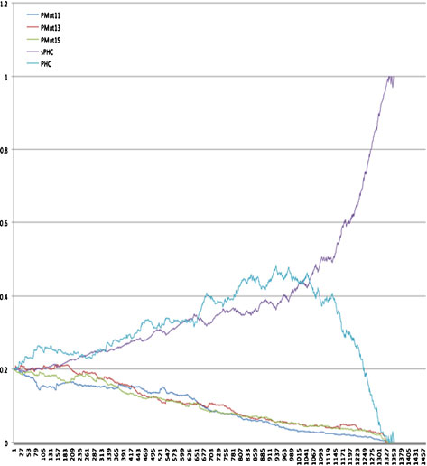

Slide 50
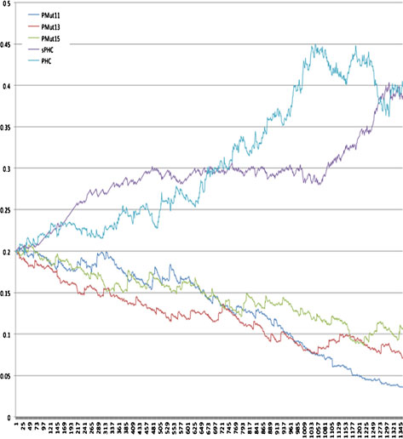

Slide 51
Conclusion
Financial forecasting
EDDIE
Results on EDDIE 8
Meta- and hyper-heuristics for EDDIE 8

Slide 52
Where to next?
Applying faster algorithms as part of the hyper-heuristics framework
Applying the meta-heuristics used by Dafni Smonou (MSc, CCFEA 2011-12) into a hyper-heuristics framework
Optimisation of the parameter values that were used in Dafni Smonou’s experiments
Application of other promising meta-heuristics

Slide 53
MSc dissertation topics
There are a few extensions to EDDIE 8, which would fit very well as an MSc dissertation topic
You would be given the source code of EDDIE and be asked to add some new java code, which would be related to heuristic search methods
  Java knowledge is required
  No need to have implemented heuristics algorithms before.
You would then apply EDDIE 8 to a different stocks and investigate on the advantages of the introduction of heuristics to the search process of EDDIE 8

Slide 54
MSc dissertation topics
Opportunity for those who are interested in a project that has real-life/industry application
  Attract industry’s interest
  Do actual research
  Possibility of publishing the results in a paper
Other advantages
  Topic is already known and research path is already established
  Somebody has already done this kind of work before. You have Smonou’s dissertation for guidance
Last year Dafni Smonou got 80% + dissertation prize. Now writing a paper for publishing her results.

Slide 55
Topic 1
Fast Local Search for EDDIE
GLS was found to be particularly effective in the EDDIE problem. However, it was also found to be very slow. We are interested in applying fast local search (or any other algorithms that can significantly improve the computational cost) and investigate its effects.
Difficulty: higher intermediate. It requires java programming skills, implementation of fast local search algorithm, and background reading on EDDIE and metaheuristic algorithms. Project also involves setting, running and analysing experiments with EDDIE.

Slide 56
Topic 2
Hyper-heuristics for EDDIE
Three metaheuristics in Dafni's dissertation were found useful. These were: Simulated Annealing, Tabu Search, and Guided Local Search. We are interested in using them in a Hyper-Heuristics framework and test its effectiveness.
Diffiiculty: lower intermediate. Project requires java knowledge (although not advanced), running and analysing research results with EDDIE. Also requires background reading on EDDIE, metaheuristics and hyperheuristics.

Slide 57
Topic 3
Meta-heuristics for EDDIE
Dafni Smonou used three meta-heuristics in her project. However, due to time constraints we did not look into different parameter settings for each heuristic. Also, algorithms like Tabu Search could have different implementations.
Difficulty: easy, if the student chooses just to play with the experimental parameters. Thus, very little programming would be involved. The project would be about understanding concepts like financial forecasting, EDDIE, meta-heuristics and hyper-heuristics. Also, the student would be expected to run many instances of different experimental parameters for each algorithm and report the results.

Slide 58
Topic 3b
The previous project could get more complex if the student decides to follow a different path, where s/he re-implements some of the meta-heuristics Smonou did, under a different perspective; for instance, Smonou focused on running local search only on the periods, without taking into account the technical indicators. Thus a student could implement algorithms that also take into account that.

Slide 59
Topic 4
A student could program and investigate the effects of one or two more meta-heuristics on EDDIE 8's search problem.
Difficulty: higher intermediate. This is a project that is very similar to Smonou's work. It requires java programming skills, implementation of two meta-heuristic algorithms, and background reading on EDDIE and meta-heuristics. Project also involves setting, running and analysing experiments with EDDIE.

Slide 60
Interested?
Talk to me after this talk
Or email me:
  M.Kampouridis.@kent.ac.uk
You can also talk to Edward about this
Joint supervision between Edward and myself
  I will be meeting you through Skype calls
  If necessary, you can visit me at the University of Kent (University of Essex will be covering the expenses)
  I might be visiting Essex as well

Slide 61
Thank you!
Questions?

Slide 62
EDDIE demo

