Slide 1
Mapping Trader Behaviour 16th February 2010 CCFEA Workshop
David Norman

Slide 2
Introduction
Good morning
The financial markets industry has a problem
Complex behaviours in trading aren’t well understood
Note: Andrew Lo ‘What happened to the Quants in 2007?’
Decision-making biases influence markets adversely
Tversky and Khaneman, Denis Hilton
Market technical infrastructure structure is flawed
Central repository for trading (exchange) now fragmented (MiFID)
Human behavioural influence is prevalent in global market design
What has this led to? Complexity for its own sake

Slide 3
Industry Update – We haven’t been here before
‘The Great Moderation’ becomes ‘The Great Unraveling’
$1 Trillion MBS/toxic loan/ bad debt writedowns
48,000 job losses on Wall Street
Unprecedented loss of reputation in Banking Industry
Investment bank collapses (Bear/Lehmans)
Massive capital provision from the Bank of England
New Mortgage applications down 90%

Slide 4
Fragmentation in Europe: MTFs
POSIT, a dark-pool MTF operated by ITG, launched in 1998.
Chi-X, launched in March 2007.
Turquoise, launched in August 2008.
Equiduct-Berliner Börse (Project running since 2008).
NASDAQ OMX Europe, launched in September 2008.
Bats Europe, launched in October 2008.
NYSE Arca Europe, launched in March 2009.
Burgundy Nordic, launched May 2009.
Quote MTF, Launched September 2009.

Slide 5
Transformation of Data Users
High Frequency traders
Hedge Funds
Quant Driven
Prop trading groups
Grey Box
Securities desks
Maximum Market coverage
Derivatives market makers
Need Consolidated Feed/Data Aggregation and Display
Order Management Systems
Execution Management systems

Slide 6
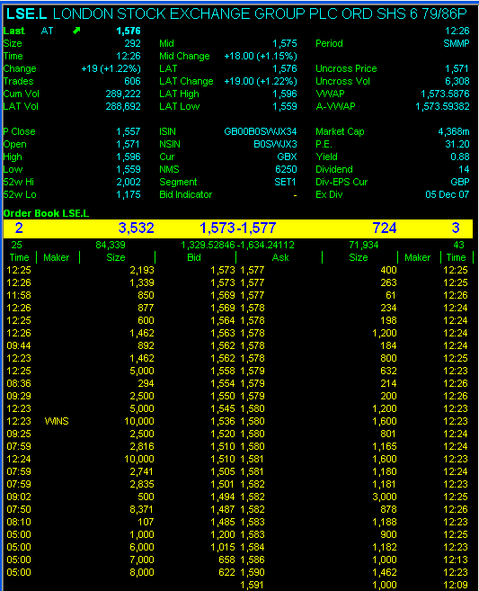
Central Limit Order Book

Slide 7
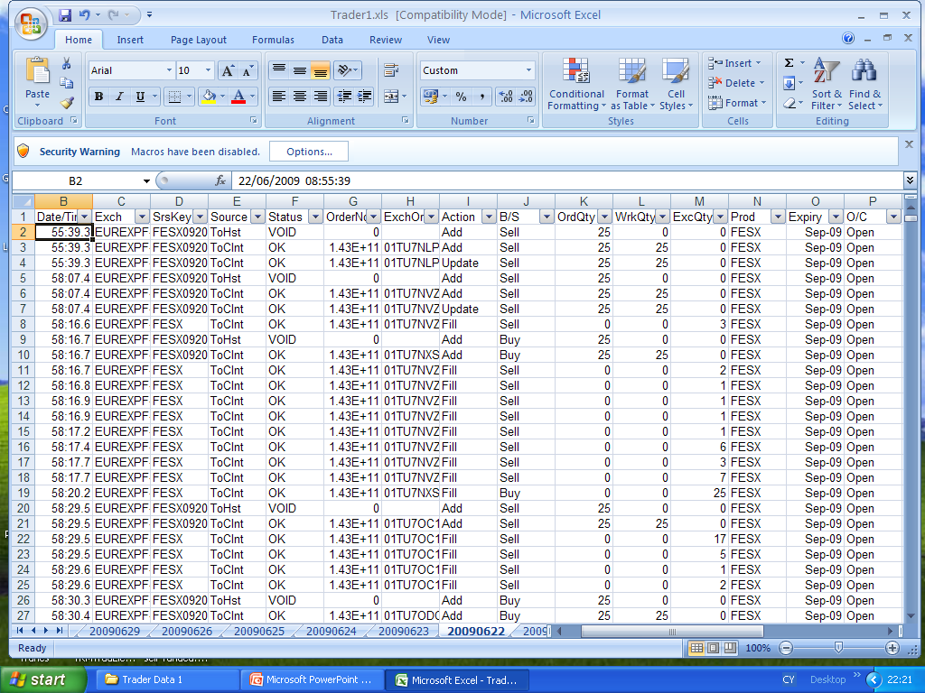
Order/Trade audit trail

Slide 8
What does this lead to?
A better understanding of why traders make decisions to trade
What has been an inexact science can now become an exact science
Past few years most emphasis has been on algo’s that improve the cost effectiveness of trade execution
In addition, there is a premarket stage referred to as the “alpha discovery phase” which is where the quants come in
Now the emphasis is on understanding human decision-making as a central component to designing new markets

Slide 9
Research Focus
Risk: Time taken and time interval metrics
Trader judgment and decision making under stress
Information processing and memory bias
Success and failure clouding
Anticipation, momentum and randomness
Peer group pressure
Opportunity to unravel complexity

Slide 10
Compare this...

Slide 11
...with this.

