Slide 1



Financial Contagion & Large-scale Agent-based Model of Financial Systems
CCFEA Workshop 2010
University of essex
16–17 February 2010
Talk by: Ali Rais shaghaghi and Mateusz Gatkowski
Project team members: Sheri Markose,
Simone Giansante, Matuesz Gatkowski and
Ali Rais Shaghaghi

Slide 2
Crisis!
World economy is suffering from the greatest economic crisis since the Great Depression in 1930s.
Alan Greenspan said this is “a century credit tsunami”.
Many central banks take “nonstandard policy”
Notes:
2

Slide 3
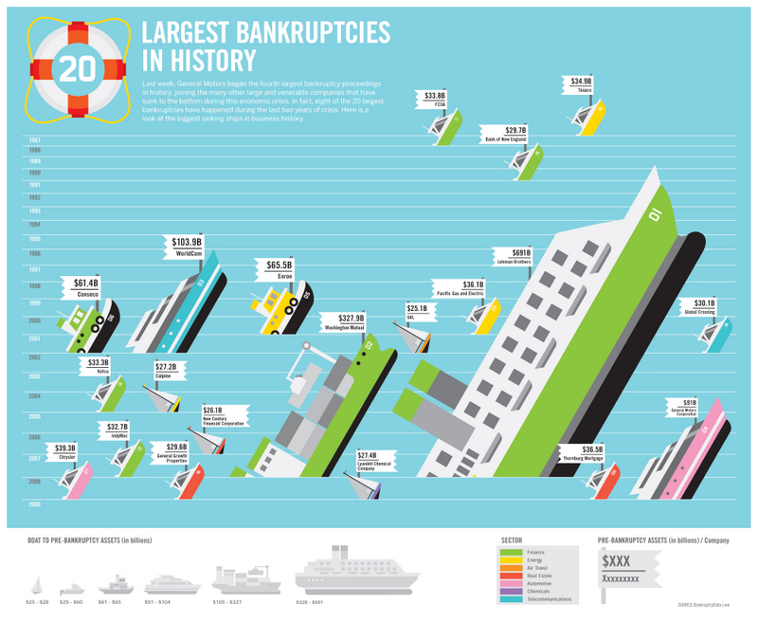
Source: Bankruptcydata.com

Slide 4
Financial Contagion
Prime Market Subprime Borrowers
Real Estate Mortgage (RMBS)
Short-term money market
Stock Market
Equity Investment
Structured Investment Vehicle (SIV)
Asset-Backed Commercial Paper (ABCP)
Repurchase agreement (REPO)
Equity Valuation
Originate
Distribute
Securitization
Structuring:
Investment Banks
Ratings Agencies
Investment Banks
Monolines
DepositsBanks
Cash
SPV
MBS (CDO) tranches,
CDS
Securities
LAPF
Hedge Fund
Asset
Investment

Slide 5
Agent-based Computational Economics
New economic paradigm rather just a toolkit
Lack of modelling tools
Markets as a complex adaptive system
Intelligent agents
  Capable of self-referential calculations and contrarian behaviour
  Surprises’ or innovation
  Network interconnectivity of agent relationships

Slide 6
Challenge
Challenges in building economics and financial models
  Difficulties in modelling human behaviour
  Immense number of individuals and entities
  addition of many data sources and available databases of various information sources including economics and financial markets, which are also available to certain extend to member of public, will give new prospects to modelling and simulation phenomena.

Slide 7
Building Agent-based Models
Simple abstraction of the individual agents and their interaction and the intelligence of the agents(Bossomaier et al 2004)
  which gives some advantage regarding presenting the dynamics within the complex system
  What here we cannot achieve is the ability to refine agents’ behaviour based on the large data and information resources.
Building a fully fledged data-driven agent-based model which requires extensive access to data sources could be challenging as many data sources exists in various formats which would raise the issue of data representation standards and communication protocols.

Slide 8
“Data is Money: How geeks are changing finance”
Convergence of interactive media, technology and finance
Future of finance will be influenced by data geeks and technologists.
The ability to take data—to be able to understand it, to process it, to extract value from it, to visualize it, to communicate it—that’s going to be a hugely important skill in the next decades

Slide 9
Economic and financial simulations often operate on static datasets (Wilson et al 2000), many simulations can provide more realistic results if they have access to dynamically changing data
Another important aspect which brings more complexity to the simulation is introduction of several parallel simulations which corresponds to various financial sectors .This could be seen as distributed simulations that need to interact and exchange data to complete a full image of the real world scenario. Bringing efficient communication, coordinating simulations and accessing several data sources whether created by individual simulations and/or data available from online sources and collected data would be significant challenge

Slide 10
The Goal
Methodological issues: Complex system Agent-based Computational Economics (ACE) for financial network modeling for systemic risk proposed: ‘Wind Tunneling Tests’
The final goal is for full digital network mapping of many key financial sectors with live data feeds ; Combine with institutional micro-structure and behavioural rules for agents to create computational agent-based test beds

Slide 11
Review of a Large-Scale ACE model
The EURACE project
  fully-fledged agent-based computational model for macroeconomic policy design and analysis
FLAME(Flexible Large-scale Agent Modelling Environment) compute cluster
Large number of agents with few types
FLAME is designed for biological modelling
They main challenge the modellers face was the flat frame work of the simulator and large amount of communications within agents

Slide 12
Diversity of Modeling
Levels and object types:
Attribute domains and topography:
Time and Synchronicity:
Stochasticity:
Linearity:
Roughly, by a complex system I mean one made up of a large number of parts that interact in a non simple way. In such systems, the whole is more than the sum of the parts, not in an ultimate, metaphysical sense, but in the important pragmatic sense that, given the properties of the parts and the laws of their interaction, it is not a trivial matter to infer the properties of the whole. In the face of complexity, an in-principle reductionist may be at the same time a pragmatic holist (HERBERT A. SIMON)

Slide 13
Modelling Environments
Environment in multi-agent simulation plays a special role
In this environment agents exist and communicate
Common vs. specific environment (Troitzsch)
Common environment is were all the agent belong to
Specific(subsystem) :
  An Agent Could be member of several specific environment

Slide 14
Different roles in different environments
Real world entities can be components of several different systems at the same time(another type of complexity)
Micro level is the same for all these kind of systems
The set of (bonding) relations or interactions is different

Slide 15
Financial Contagion
Prime Market Subprime Borrowers
Real Estate Mortgage (RMBS)
Short-term money market
Stock Market
Equity Investment
Structured Investment Vehicle (SIV)
Asset-Backed Commercial Paper (ABCP)
Repurchase agreement (REPO)
Equity Valuation
Originate
Distribute
Securitization
Structuring:
Investment Banks
Ratings Agencies
Investment Banks
Monolines
DepositsBanks
Cash
SPV
MBS (CDO) tranches,
CDS
Securities
LAPF
Hedge Fund
Asset
Investment

Slide 16
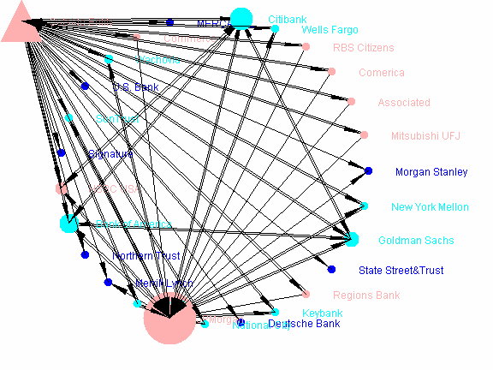
Two separate models has been created partially
Model
CDOs Secondary
Market
Insurance
ABX Tranches
Banks
.
.
.
Pension Funds
Hedge Funds
Mortgagees
CDO originators
Banks

Slide 17
Agent Roles
For example a(bank) buying CDS from protection seller b, within the financial CDS market
A method is been proposed by Antunes et al, that agents move in different environments(“an agent can belong to social relations, but possibly not simultaneously”) which differs from real world perspective

Slide 18
Sub-agent Architecture
Within this framework each subagent will operate in different environment
Sub-agents will communicate accordingly to the top level agent to form the higher level behaviour
This approach will enable the modeller to add further functionality to agents
Specific Environment
Specific Environment
Common Environment

Slide 19
Sub-agent Architecture
The proposed method would enable the modeller to separately model each individual environment
The agent within the specific environments will be incorporated to the common model by transforming the agents to sub agents of the new environment
The agent will be responsible to

Slide 20
Andrew Haldane, Bank of England
Comparing Lehman’s collapse and epidemic of bird-flu:
„These similarities are no coincidence. Both events were manifestations of the behaviour under stress of a complex, adaptive network. Complex because these networks were a cat’s-cradle of interconnections, financial and non-financial. Adaptive because behaviour in these networks was driven by interactions between optimising, but confused, agents. Seizures in the electricity grid, degradation of ecosystems, the spread of epidemics and the disintegration of the financial system – each is essentially a different branch of the same network family tree.”
Andrew Haldane, Executive Director, Financial Stability Department, Bank of England

Slide 21
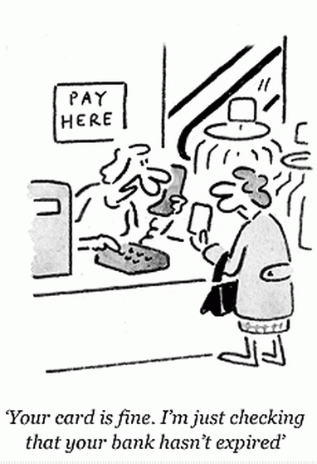
Proactive regulation
Idea of self-organising markets was supported by Hayek
We cannot simply design from scratch a "new regulatory framework" and let things run
If we put in place a set of constraints and rules today they will have to be continually adapted as markets adapt

Slide 22
Credit Default Swap (CDS) Structure
B
Default Protection from CDS Buyer
C
Default Protection Seller
“INSURER”
(AIG)
Premium in bps
Payment in case of Default of X
= 100 (1-R)
Now 3rd party D receives
insurance when A defaults; B still owns A’s Bonds !
Party D has incentive to short A’s stocks to trigger failure :Bear Raid
B sells CDS to D
A
Reference Entity (Bond Issuer) or CDOs

Slide 23
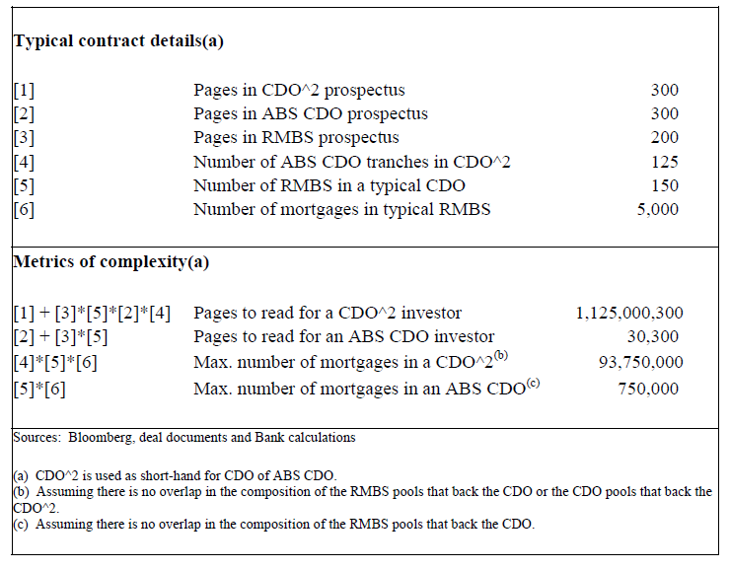
CDO of CDO – complexity explosion
Source: Andrew Haldane: „Rethinking The Financial Network”, Speech, Amsterdam, April 2009

Slide 24
20 Banks With CDS Positions ($bn)
Name | CDS Buy | CDS Sell | Core Capital | Mortgage Backed Securities | Loans & Leases | Charge Offs
JPMorgan Chase Bank | 4,166.76 | 4,199.10 | 100.61 | 130.33 | 663.90 | 12.75
Citibank | 1,397.55 | 1,290.31 | 70.98 | 54.47 | 563.24 | 10.81
Bank of America | 1,028.65 | 1,004.74 | 88.50 | 212.68 | 712.32 | 13.68
Goldman Sachs Bank USA | 651.35 | 614.40 | 13.19 | 0.00 | 4.04 | 0.08
HSBC Bank USA | 457.09 | 473.63 | 10.81 | 20.92 | 83.25 | 1.60
Wachovia Bank | 150.75 | 141.96 | 32.71 | 32.83 | 384.99 | 7.39
Morgan Stanley Bank | 22.06 | 0.00 | 5.80 | 0.00 | 14.85 | 0.29
Merrill Lynch Bank USA | 8.90 | 0.00 | 4.09 | 3.00 | 24.59 | 0.47
Keybank | 3.88 | 3.31 | 8.00 | 8.09 | 77.39 | 1.49
PNC Bank | 2.00 | 1.05 | 8.34 | 24.98 | 75.91 | 1.46
National City Bank | 1.29 | 0.94 | 12.05 | 11.95 | 102.40 | 1.97
The Bank of New York Mellon | 1.18 | 0.00 | 11.15 | 29.29 | 2.85 | 0.05
Wells Fargo Bank | 1.04 | 0.49 | 33.07 | 60.15 | 348.35 | 6.69
SunTrust Bank | 0.59 | 0.20 | 12.56 | 14.85 | 131.06 | 2.52
The Northern Trust Company | 0.24 | 0.00 | 4.39 | 1.37 | 18.98 | 0.36
State Street Bank and Trust Company | 0.15 | 0.00 | 13.42 | 23.03 | 9.13 | 0.18
Deutsche Bank Trust Company Americas | 0.10 | 0.00 | 7.87 | 0.00 | 12.86 | 0.25
Regions Bank | 0.08 | 0.41 | 9.64 | 14.30 | 98.73 | 1.90
U.S. Bank | 0.06 | 0.00 | 14.56 | 29.34 | 183.76 | 3.53
RBS Citizens | 0.00 | 0.06 | 8.47 | 19.75 | 92.24 | 1.77
Note: FDIC Data; All figures in $bn

Slide 25
Percentage share in CDS market
CDS - buy
CDS - sell
Note: FDIC Data; 4Q 2008

Slide 26
Buying CDS cover from a passenger on Titanic
Monolines (AMBAC, MBIA, FSA) traditionally dealt with municipal bond enhancements to achieve AAA rating; they began to insure prime and subprime MBS/CDOs
On a $20bn wafer thin capital base, they insure $2.3 tn; this led to massive loss of market value of the Monolines as RMBS assets began to register large defaults.
Monolines are predominantly CDS protection sellers
Merrill Lynch takeover arose from a lesser known Monoline insurer ACA failing to make good on the CDS protection for RMBS held by Merrill as assets; Merrill’s net subprime exposure from RMBS on its balance sheet became a gross amount when the CDS on it was reckoned to be worthless

Slide 27
Too Interconnected To Fail Experiments
Build CDS Network and Conduct Stress Tests.
There is very high correlation between the dominance of market share in CDS and CDS network connectivity.
We use 20% reduction of core capital to signal bank failure.
Experiment 1: (A) The loss of CDS cover due to the failed bank as counterparty suspending its guarantees will have a contagion like first and multiple order effects. Full bilateral tear up assumed.
Experiment 2: Experiment 1 + (B) trigger bank is also a CDS reference entity activating CDS obligations from other CDS market participants + (C) Loss of SPV cover and other credit enhancement cover from failed bank.

Slide 28
Database
As mentioned earlier data plays a crucial rule in building such models
A database system containing US banks balance sheet data is been designed and created(FDIC and DTCC data sources)
The interconnection between agents(banks) is based on a network model

Slide 29
CDS ACE Network Model

Slide 30
Simulator!

Slide 31
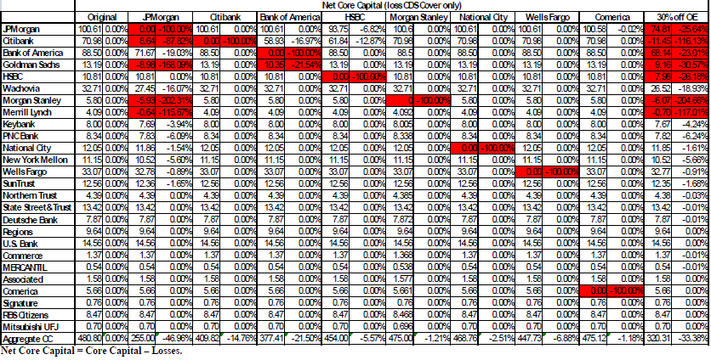
Results: Experiment 1

Slide 32
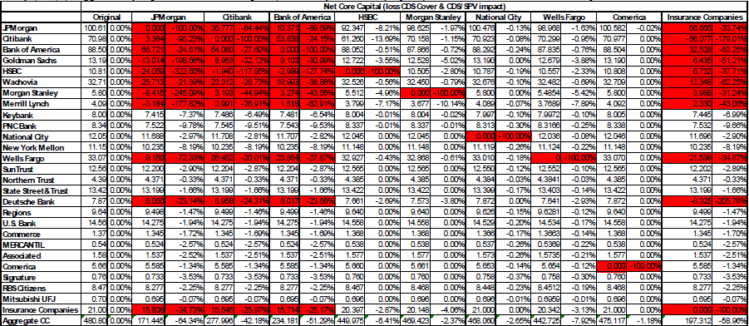
Results: Experiment 2

Slide 33
Systemic Risk Ratio SRR
JP Morgan has a SRR of 46.96% implying that in aggregate the 25 US banks will lose this percentage of core capital with Citibank, Goldman Sachs, Morgan Stanley and Merrill Lynch being brought down.
The demise of 30% of a non-bank CDS protection seller (such as a Monoline) has a SRR of 33.38% with up to 7 banks being brought down.
SSR Bank of America: 21.5%, Citibank: 14.76%, Wells Fargo: 6.88%. The least connected banks in terms of the CDS network, National City and Comerica have SSRs of 2.51% and 1.18%.
The premise behind too interconnected to fail can be addressed only if the systemic risk consequences of the activities of individual banks can be rectified with a price or tax reflecting the negative externalities of their systemic risk impact to mitigate the over supply of a given financial activity.

Slide 34
CDS Banks Sovereigns
Source: Datastream

Slide 35
CDS US Banks vs Non US Banks
Source: Datastream

Slide 36
EWMA correlation
EWMA conditional correlation when number of periods included in average tends to infinity can be expressed in an autoregressive form:

Slide 37
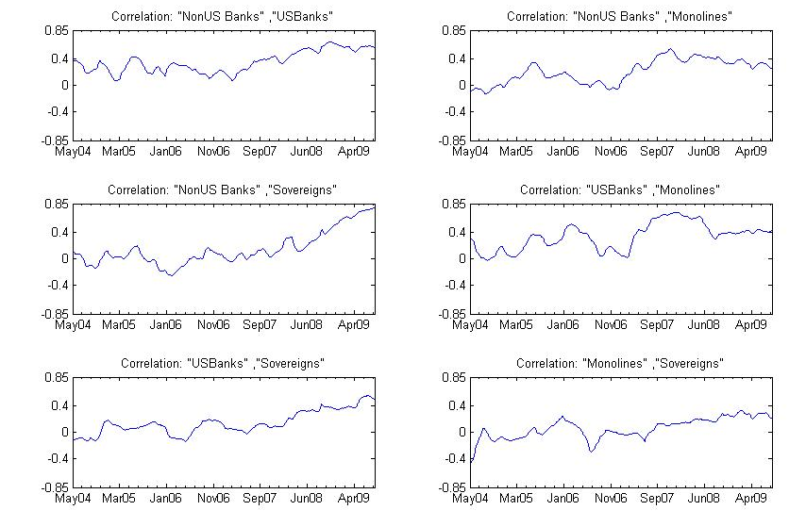
Some results…

Slide 38
When contagion started
,
ρ_{τ} = α₀ + α₁ ρ_{τ−1} + α₂Δ_{τ} + ε_{τ}
,
 | D₁ | D₂ | D₃ | D₄
Experiment: Average US banks on non banks
t-statistics | -1,996*** | -1,04 | -1,677** | 0,109
p-value | 0,046 | 0,298 | 0,094 | 0,913
Experiment: Average non banks on sovereigns
t-statistics | -2,255** | -1,536 | -2,343*** | -0,764
p-value | 0,024 | 0,124 | 0,019 | 0,444
Experiment: German banks on Germany
t-statistics | -1,7** | -2,242*** | -3,678*** | -4,371***
p-value | 0,089 | 0,025 | 0,0002 | 1,30E-05

Slide 39
Granger-causality
Main assumption - if one variable causes the other it should help to predict it, by increasing accuracy of forecasts
In order to test for Granger-causality between x and y - estimate an autoregressive model with lag p, and test for the null hypothesis:
x_{t} = a₀ + a₁ x_{t-1} + a₂x_{t-2} + ... + a_{p}x_{t-p} + b₁ y_{t-1} + b₂y_{t-2} + ... + b_{p}y_{t-} e_{t},
H₀: b1 = b2 =… = bp = 0

Slide 40
Where it all started…
,
Variable | Non US Banks | US Banks | Monolines | Sovereigns
Non US Banks | x | 0,00 | NaN | 0,07
US Banks | 0,00 | x | NaN | NaN
Monolines | NaN | 0,00 | x | 0,03
Sovereigns | NaN | 0,00 | NaN | x
Variable | US Banks | USA
US Banks | x | NaN
USA | 0,00 | x
Variable | Sovereigns | USA
Sovereigns | x | 0,03
USA | NaN | x
Variable | Investment banks | Other banks
Investment banks | x | NaN
Other banks | 0,00 | x
,

Slide 41
Take one measure of econometrics and two measures of Agent-Based…
,
Let’s compute correlation between CDS of bank A and bank B
Check how strong it is at the start of epidemic
Feed it into ACE model of CDS network…

Slide 42

How to cook it with ACE?
,

Slide 43
Further Work
Using an agent based formalism to describe large agent-based models with multiple environments and components
Investigate the coordination and communication of sub agents and design issues

Slide 44
Thank you for attention.
Questions

