Slide 1
International Portfolio Optimization using Regime Switching: Case of Subcontinent
Presenter:
IQBAL, JAVED
Presented on: 17 February 2010
CCFEA Workshop 2010

Slide 2
Structure of our Presentation
Introduction:
What is Regime Switching (RS)
Stylised facts and brief Literature Review
Methodology:
The Capital Asset Pricing Model (CAPM)
Maximum Likelihood Estimation
Data Description & Analysis
Descriptive Statistics
RS model without Short Selling
RS model with Short Selling
Conclusion
Q & A

Slide 3
What is Regime Switching?
“Formally Regime Switching models refer to a situation in which stock market returns are drawn from two different distributions, with some well defined stochastic process determining the likelihood that each return is drawn from a given distribution”
Newmann (1997).

Slide 4
Examples of Regimes
Exchange rates have periods of appreciation and depreciation vis-à-vis other currencies.
Economic business cycles have boom and bust periods.
Equity markets are characterized by bull and bear markets.
Asset prices also have prolonged periods of upward movement followed by downward movements.

Slide 5
Brief History of Regime Switching Models and Literature Review

Slide 6
Markov Switching Models (MSM), go back as far as Quandt(1958), Goldfeld and Quandt (1973)
Hamilton (1989) extended MSM to dependent data using GARCH models on GDP data
RS models have subsequently extended to other areas of finance and economics, for example in Asset allocation (Ang and Bekaert, 2002), Government spending (Nelson 2003), Levels of mergers and acquisition, energy market spot prices, interest rates and exchange rates.

Slide 7
Stylised facts of asset pricing
Stylised facts of asset returns show that during bull markets and bear market returns, volatility and correlations behave differently.
In the latter, returns are lower, volatility is higher, and asset correlations increases. A phenomenon known as Asymmetric Correlation.
Ang and Bekaert (2002) concluded that there was significant evidence of Asymmetric correlation. Correlation between these assets tended to be higher when there were market downturns. On average they were 20% higher than in the normal regime. They statistically rejected at 0.01% significance the equality of volatility across regimes.
Hess (2006) reported volatility in turbulent times, can be 2.2 times higher than in calmer periods

Slide 8
Stylised facts of asset pricing (contd..)
Recent studies confirm that the conditional moments of stock returns are business cycle related, this results in the distribution of stock market returns to be time-varying, (Hess, 2006). Therefore the optimal portfolio in bear markets is substantially different from the one in bull markets.
Ang and Bekaert (2004) noted that the presence of asymmetric correlation has raised doubts about the benefits of diversification especially in market downturns.

Slide 9
Why International Indices?
Globalization
Diversification of Risk
International integration has caused correlation to go high but variance of foreign portfolios declined giving a rationality to invest in foreign markets (Karen, 2006).
Co-movement in troubled times has increased especially in troubled times (Flavin and Panopoulou, 2006).

Slide 10
(contd..)
For example, during periods of high U.S. variance, foreign markets become highly correlated with the U.S. market. This has considerable affect on the formulation of portfolio diversification strategies (Ramchand and Susmel, 1998).
Assoe (1998) showed that emerging markets go through two regimes whether the market returns are expressed in respective local currencies or in U.S. dollars.

Slide 11
(contd..)
Ang and Bekaert (1999) concluded that “the costs of ignoring regime switching are small for moderate levels of risk aversion;” whereas Das and Uppal (2004) state that “there are substantial differences in the portfolio weights across regimes.”

Slide 12
Methodology

Slide 13
Methodology
To model regime switching, we adopt a model similar to that used by Ang & Bekaert (2004) and Markose & Yang (2008).
The CAPM assumptions are assumed to be satisfied
The CAPM equation is:
= excess return on security i for a given period, at time t
= excess return on market index for a given period, at time t
= intercept term
=slope term

Slide 14
Total risk of security i,
measured by its variance equals the following:
= variance of returns on the market index.
Specific/ idiosyncratic risk. As this risk can be eliminated through diversification, this risk is not rewarded.
Systematic / Market risk, this is the proportion of total risk that is priced, it is un diversifiable.

Slide 15
The state dependent model is thus affected by the regime via the market index realised regime, according the markov chain rule
denotes the regime variable whose value depends on regime realization (1 or 2) of market index,
denotes the regime-dependent mean of excess return on market index
denotes the regime-dependent conditional volatility, measured by standard deviation.

Slide 16
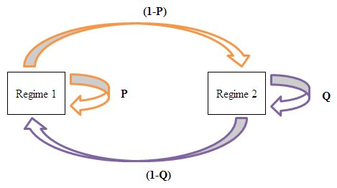
THE CONDITIONAL TRANSITION PROBABILITIES (MARKOV CHAIN RULE):

Slide 17
PARAMETERS TO ESTIMATE:
θ = {µ1, µ2, σ1, σ2, P, Q}
the filter probability (ex-ante probability)
Regime Probability which is the inference about the process being in some particular regime at time t basis on the information available at time t;
the smoothed probability (ex-post probability)
The smoothed probabilities are the interference about the historical regimes the process was in at some point t. and it is based on the full sample information.

Slide 18
METHOD: MAXIMUM LIKELIHOOD
Hamilton (1989) offers an approach on how to model regime changes when the shifts are not directly observable but statistically inferred through observing the behaviour of the series.
In the two state RS model, we assume the model is drawn from two normal distributions and the mean, variance, correlations are state dependent. The conditional density function for rmt (St), St =1, 2:

Slide 19
L {θ} =

Slide 20
and
(1)
(2)

Slide 21
and
(3)
and
(4)
We iterate the process in (1), (2), (3) and (4) till the values for П1*, µ1* and б1, for state 1 and 2 stabilize.

Slide 22
DATA DESCRIPTION AND ANALYSIS

Slide 23
Data Analysis & Description
Data used is monthly index values for three Subcontinent stock Exchanges from December 1993 to July 2009. These stock indices are Karachi Stock Exchange (KSE), Bombay Stock Exchange (BSE) and Dhaka Stock Exchange (DSE). The MSCI World is used as the market index, a proxy of GDP. It is generally accepted that that business cycles drive regimes in the stock market, (Markose and Yang, 2007)
The monthly US T-Bill Rate is used as the risk free return, to facilitate the calculation of excess returns.
The sample period is December 1993 to July 2009, totalling 185 observations for each stock index.
In Sample 1994-1999
Out of Sample 2000-2009

Slide 24
Statistical Description of Three Indices : Whole Data
Whole Sample : January 1994 -July 2009
Observations: | 185
Descriptive Statistics | KSE | BSE | DSE | MSCI
Mean | 0.007736718 | 0.007078312 | -0.00052467 | 0.00297923
Variance | 0.010660245 | 0.007738875 | 0.006075785 | 0.002058534
Std Deviation | 0.10324846 | 0.087970877 | 0.077947321 | 0.045371066
Excess Kurtosis | 5.915471363 | 0.088971547 | 2.56534842 | 2.771351387
Skewness | -1.27637547 | -0.38747051 | -0.029437787 | -1.107038957
OLS Regression
Intercept | 0.002112 | 0.002359 | 0.003919
Slope | 0.058243 | 0.035381 | 0.254823
Covariance Matrix
 | 0.010602622 | 0.002289254 | 0.001142067 | 0.000176949
BSE | 0.002289254 | 0.007697043 | 0.000444839 | 0.000174339
DSE | 0.001142067 | 0.000444839 | 0.005968859 | 0.001548014
MSCI | 0.000176949 | 0.000174339 | 0.001548014 | 0.002047525
Correlation Matrix
KSE | 1 | 0.253410925 | 0.142104097 | 0.037964878
BSE | 0.253410925 | 1 | 0.064962548 | 0.043901024
DSE | 0.142104097 | 0.064962548 | 1 | 0.438943673
MSCI | 0.037964878 | 0.043901024 | 0.438943673 | 1

Slide 25
Regime Estimates and Transition Probabilities
 | Regime 1 |  | Regime 2 |  | Transition Probability
 | µ1 | σ1 | µ2 | σ2 | P | Q
Estimates | 0.37 | 1.75 | -3.13 | 4.27 | 0.9814 | 0.5501
Standard Error | 0.0012 | 0.0237 | 0.0010 | 0.0098 | 0.0166 | 0.2391

Slide 26
Data Analysis & Description (Contd..)
In addition to the parameters reported in Table 1, the model can also infer the Regime probabilities i.e.
      filter probabilities and
      smoothed probabilities.
The filter probabilities indicate the process being in some particular regime at time t based on the information available at the time t-1.
In contrast to filtered probabilities, the smoothed probabilities indicate the historical regimes the process was in at time t based on whole sample information and are calculated backwards by using filter and forecasting probabilities

Slide 27
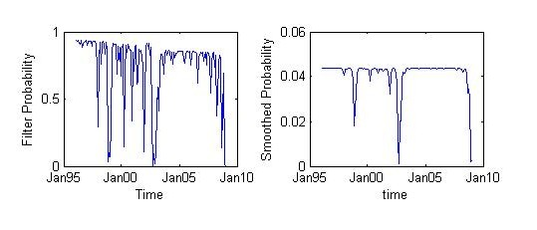
Smoothed vs. Filtered Probabilities

Slide 28
Monthly Portfolio Optimization
To test the regime switching portfolio optimization and its performance over the out of sample period (6 years), we used the following three strategies:
    Regime switching (RS) mean-variance optimization
    Non-RS mean-variance optimization
    Market capitalization weights portfolio

Slide 29
Monthly Portfolio Optimization (Contd.)
1 GBP initial investment in the out-of-sample data starting from Jan 2000.
By using the actual prices on the following month, we calculated the returns and all the profits were reinvested into the three portfolio strategies.
The three different strategies were further divided on the basis of
  Short selling approach and
  No short selling approach

Slide 30
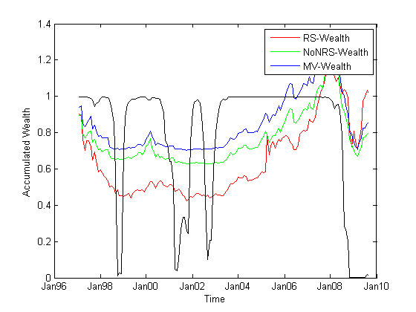
Accumulated Wealth with No Short-Selling

Slide 31
No Short-Selling Approach (Contd)
These properties suggest that regime switching portfolio optimization would benefit from actively rebalancing portfolio weights and would capture effectively the changing trends of equity market. Hence, RS strategy can be proved as forward looking as compared to other two strategies which are backward looking (relying on past events after they have happened).

Slide 32
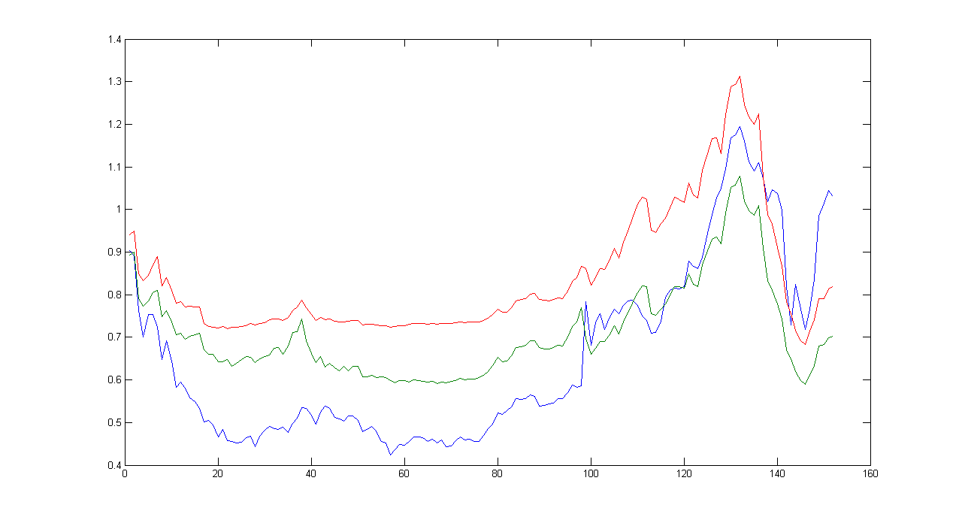
Accumulated wealth with Short-Selling

Slide 33
Short-Selling Approach (Contd..)
Since there is no restriction on short selling, the portfolio weights can go negative or above 1. In this case, RS strategy enjoys more flexibility and utilises its capability to infer about regimes and taking the right advantage of its forward looking behaviour.

Slide 34
Conclusion
Shown evidence of RS in equities market, empirically and analytically
Results shows: µ1> µ2, σ1< σ2.
On average regime 1 expected return and standard deviation are .37% and 1.75% per month respectively, while for regime 2 these values are -3.13% and 4.27% per month.
Evidence of regime persistence especially for the stable regime, P=0.9818
£1 invested in active RS portfolio outperformed non-RS and market capitalisation strategies. Expected returns from RS strategies vs. non-RS in all scenarios, on average you would expect to get 50% more on average from applying dynamic RS strategies!!
There were large market timing benefit which were more prominent when we included a risk free asset in to the portfolio and for the risk lover

Slide 35
RECOMMENDATIONS
Our model omitted transaction costs, these will significantly impact the profit especially when we consider monthly rebalancing applied in our model
Since there is evidence of regime persistence ARMA models may be considered and compared against the CAPM framework
Although it is a simple model with 2 regimes and 3 assets, the RS model incorporated in this study can be extended to multiple regimes and assets
The value of Beta has been shown to vary, for example when we looked at the post dotcom bull or bear scenario. Further areas of research in this area may consider including time varying beta.

Slide 36
Q & A

