Slide 1
Introduction to the Mexican Derivative market (MexDer) and two Mexican cases of hedging
Jose Cordoba Gonzalez
jmcord@essex.ac.uk
CCFEA Research Workshop
16th - 17th February 2010
Centre for Computational Finance and Economic Agents
University of Essex

Slide 2
Agenda
1. Introduction
For Mexico, oil has been the main source of income for the public sector.
2. MexDer (Mexican Derivative Market)
IPC (like FTS 100), TIIE (like LIBOR) and VIMEX (like VIX, Volatility Index)
1. Comercial Mexicana
2. Mexican Oil hedging
1. Three final remarks (1 slide)
First part
Second part
Conclusion

Slide 3
1 Introduction: Mexico
First part
“The Mexican government relies upon earnings from the oil industry for about 40 percent of total government revenues”
According to the U.S. Energy Administration (EIA): “in 2008, Mexico was the seventh-largest oil producer in the world, and the third-largest in the Western Hemisphere”.
“Stated-owned Petroleos Mexicanos (Pemex) holds a monopoly on oil production in the country and is one of the largest oil companies in the world”
Source: EIA. “Country Analysis Brief – Mexico.
Energy Information Administration. March 2009.

Slide 4
1 Introduction: Mexico
Source: EIA. “Country Analysis Brief – Mexico.
Energy Information Administration. March 2009.

Slide 5
1 Introduction: Mexico
“Despite the fact that Mexico is one of the largest crude oil exporters,
Mexico is a net importer of refined petroleum products.
In 2008, Mexico imported 550,000 bbl/d (barrels per day) of refined petroleum products, while exporting 192,000 bbl/d”.
Source: EIA. “Country Analysis Brief – Mexico.
Energy Information Administration. March 2009.

Slide 6
1 Introduction: Mexico
Limited domestic refining capacity.
“Mexico’s oil consumption averaged 2.1 million bbl/d in 2008. Mexico has six refineries, all operated by Pemex, with a total refining capacity of 1.5 million bbl/d”.
“In order to reduce its imports of refined products, Pemex plans to build at least one additional refinery in Mexico.
Pemex announced that the cost of its plans to build a new refinery, 300,000-bbl/d refinery , is $10,000,000,000 dollars”.
Source: EIA. “Country Analysis Brief – Mexico.
Energy Information Administration. March 2009.

Slide 7
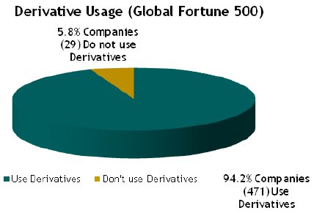
2 Derivative markets in the world…
ISDA did a survey of derivatives usage by the world's 500 largest companies. "According to this survey, 94% of these companies use derivatives instruments to manage and hedge their business and financial risks" (ISDA, 2009)

Slide 8
4 MexDer
The Mexican market derivative (MexDer)
Source: MexDer(2009)

Slide 9
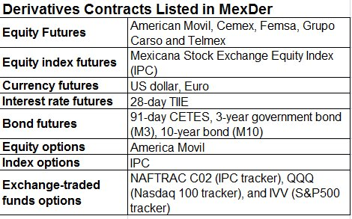
4 MexDer products
*Exchange traded funds (NAFTRAC02, which tracks the IPC;
the QQQ, which tracks the Nasdaq 100 index; and
the IVV, which tracks the S&P 500)
Source: IMF(2007)

Slide 10
4 MexDer
John Mathias who is the director of financial futures & options at Merril Lynch International in London said “what distinguishes MexDer from many other markets is its willingness to adapt to international business practices.”
Source: Mathias(2007)

Slide 11
4 MexDer. TIIE
“When markets required unbiased references for their workings, the central bank provided them: the 28-day TIIE,” according to Sidaoui(2009).
TIIE = Tasa de Interes Interbancaria de Equilibrio. The TIIE is the benchmark interbank interest rate that Mexican banks use to borrow or lend from the Bank of Mexico. (Source: MYSMP(2009))
Calculated daily by Central Bank taking arithmetic mean of quotes submitted by at least 6 commercial bank quotations, according to Keulen (2007).
LIBOR (London Interbank Offered Rate) is a reference rate for dealing in Eurodollar time deposits
between commercial banks in the London Interbank Market. LIBOR often is the benchmark rate
for commercial loans, mortgages, and floating rate debt issues.

Slide 12
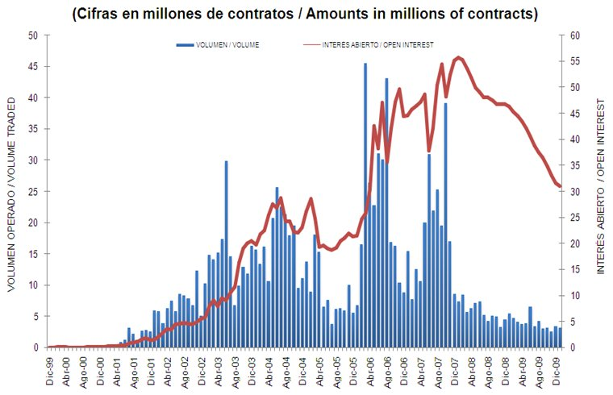
3 Evolution of the Mexican Derivative Market
Evolution: Future contracts in MexDer
Source: MexDer(2009)

Slide 13
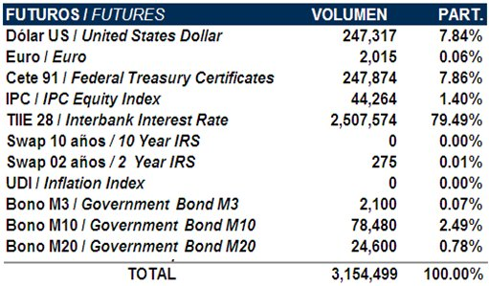
3 Evolution of the Mexican Derivative Market
Futures in MexDer in January 2010
Volume
(number of
contracts)

Slide 14
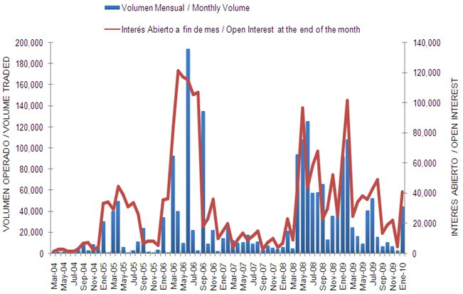
3 Evolution of the Mexican Derivative Market
Evolution: Option contracts in MexDer

Slide 15
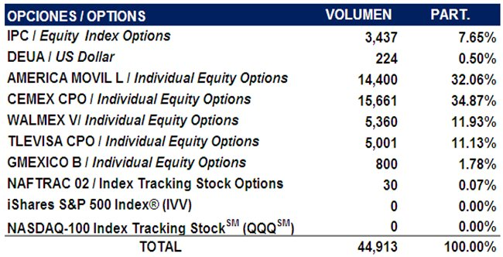
3 Evolution of the Mexican Derivative Market
Options in MexDer in January 2010
Volume
(number of
contracts)
Source: MexDer(2009)

Slide 16
4 MexDer. VIMEX
VIMEX = The Mexican Implied Volatility
MexDer calculates “an implied volatility which is obtained from option contracts on IPC” [Indice de Precios y Cotizaciones] (similar to FTS 100 index or IBEX 35) (Source: Mexder (2009))
Benefit of VIMEX: To know the level of volatility that the market expects in the short-term according to MexDer (2009)
VIMEX was constructed by the methodology of Fleming, Ostdiek and Whaley
“Predicting stock market volatility: a new measure”, The Journal of Futures Markets,
Vol. 15 (3): 265-302). 1995.

Slide 17
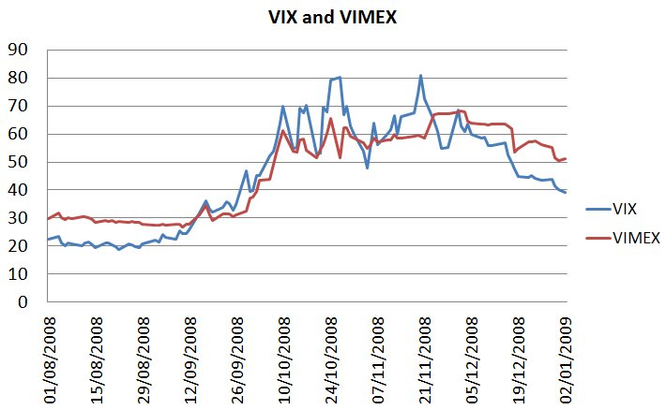
4 MexDer. VIMEX vs VIX VOLATILITY S&P 500(Chicago Options: ^VIX)
Bill Luby said: “absolute VIX levels are much less meaningful than the current level of the VIX in relation to recent levels”.
Source: MexDer (2008) and Yahoo Finance

Slide 18
2 Hedging
Second part
“Hedging involves taking an offsetting position in a derivative in order to balance any gains and losses to the underlying asset,” Inv (2010).
Source: Investopedia(2010), Kolb and Overdahl “Financial Derivatives,
Pricing and Risk Management” 2009.

Slide 19
1. Major financial risk in firms
Hedging Instruments
1. Interest Rate Risk
Interest Rate Swaps (Swaptions)
Interest Rate Futures
2. Currency risk
FX Options
FX Forwards
3. Commodity risk
Commodity Options
Commodity Swaps
Commodity Forwards
*Based on Linnertova (2008). “Derivatives and Risk Management. Hedging risks” by Sarah Dees

Slide 20
2 Hedging vs. Speculation
On the other hand, speculation is to accept a derivative contract “in order to profit by taking risks”. “Hedgers are seen as risk averse and speculators are typically seen as risk lovers,” Inv(2010)
Kolb (2009) recommends “a true assessment of whether someone is speculating or hedging, therefore, requires an assessment of their motivations for entering into a derivatives position”
Source: Investopedia(2010), Kolb and Overdahl “Financial Derivatives,
Pricing and Risk Management” 2009.

Slide 21
3 Comercial Mexicana
“Should a grocery chain be selling volatility protection?, This is a profound ethical issue. The responsibility is shared. It is 50% the fault of the people at the company who decided to put its balance sheet at risk; but it is also 50% the responsibility of the investment banks for even proposing such operations”
said Guillermo Ortiz, ex-Central bank governor in Mexico
*Source: Magazine Euromoney, “Ortiz condemns unethical bank behaviour”. November 2008, Vol. 39, Issue 475.

Slide 22
3 Comercial Mexicana
Name of the contract:
Non-Deliverable Forward (NDF)
NDFs is non-standardized futures contract
“Under an NDF, a currency that is not freely convertible such as Taiwanese dollar, is specified against a freely convertible currency (this is typically the USD),” Credit Suisse (2009).
Source: Credit Suisse (2009)

Slide 23
3 Non-Deliverable Forward
NDFs is non-standardized futures contract
“At maturity, the reference rate) is compared with the NDF rate. The difference must be paid in the convertible currency (USD) on the value date.”
“For example, forwards in the Taiwanese dollar (TWD) do not exist, the solution is NDF. NDFs make it possible to hedge the exchange-rate risk.”
Source: Credit Suisse (2009)

Slide 24
3 Example of Non-Deliverable Forward
A firm receives TWD (Taiwanese dollar) 32,600,000 at a specified point in time that it wishes to convert into USD
The forward rate: 32.60 Term: 6 months
Rate at maturity: 35.00 (assumption)
Calculation of the difference:
32,600,000 - 32,600,000 = USD 68,571.43
32.60 35.00
In this case,
Forward rate < Rate at maturity (NDF rate)
*Example was obtained from the Credit Suisse (2009)

Slide 25
3 Example of Non-Deliverable Forward
Amount: (Taiwanese dollar) 32,600,000
32,600,000 - 32,600,000 = USD 68,571.43
32.60 35.00
In this case,
32.60 < 35
Forward rate < Rate at maturity (NDF rate)
(TWD appreciated then the Bank pays in USD)
then, the Bank pays USD 68,571 (the difference) to the
client.
*Example was obtained from the Credit Suisse (2009)

Slide 26
3 Example of Non-Deliverable Forward
Amount: (Taiwanese dollar) 32,600,000
32,600,000 - 32,600,000 = - USD 86,666.66
32.60 30.00
However, if the NDF rate (rate at maturity) is
32.60 > 30
Forward rate > Rate at maturity (NDF rate)
(Mexican peso depreciated due to the Lehman
Brother’s bankruptcy then the client pays in USD)
then, the client pays USD 86,666 (the difference) to the
bank.
*Example was obtained from the Credit Suisse (2009)

Slide 27
3 Comercial Mexicana
“Comercial Mexicana was the third largest supermarket chain in Mexico such as TESCO, has been forced to file for bankruptcy protection as a result of the depreciation of the Mexican peso affecting their derivatives contracts. A month after the collapse of Lehman Brothers, the peso dropped by more than 30% and the companies were forced to sell double the amount of US dollar at the higher price. Comercial Mexicana could not pay US$ 1,4 billion to the banks on October 9, 2008.”
*Source: Business Latin America,
October 20th 2008.

Slide 28
8 Comercial Mexicana
“After two unsuccessful attempts to obtain bankruptcy protection, Comercial Mexicana had been persuaded by its creditors to pursue an out-of-court restructuring”, according to Latin American Law Report (2008).
Comercial Mexicana offers creditors
USD 450 million in cash according to Debtwire, December 8, 2008.
*Source: Business Latin America,
October 20th 2008.

Slide 29
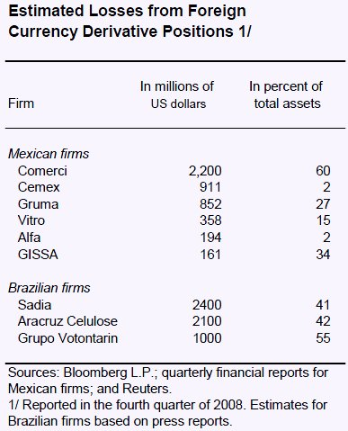
8 Comercial Mexicana(Comerci)
IMF considers as speculative behaviour. They wrote “the financial turbulence in October 2008 revealed substantial off-balance-sheet currency exposures associated with speculative derivative positions in a number of large corporations in Brazil and Mexico.”
*Source: IMF. “Regional Economic Outlook:
Western Hemisphere. May 2009.

Slide 30
9 The Mexican oil hedging
In summer 2008, as Mexico planned its 2009 budget, the oil price was high – but Agustin Carstens who is actually the Central bank governor thought that the price could change.
“In July and December 2008, the West Texas Intermediate crude fell from $145 to $38 a barrel. Mexican oil is a heavier and cheaper mix. The crash could have knocked a terrible hole in the government’s revenue.”
*Source: Reuters(2009)
West Texas Intermediate (WTI) is a type of crude oil used as
a benchmark in oil pricing and the underlying commodity of
New York Mercantile Exchange’s oil futures contracts.

Slide 31
9 The Mexican oil hedging
Countreparties including Deutsche Bank, Barclays, Goldman Sachs and Morgan Stanley, according to Reuters(2009). Hedging 330m barrels of oil at $70 a barrel – the price on which the Mexican budget had been based
Cost: $1.5 billion for put options
Amount of gains in 2009: $5.085 billion from 2009 oil hedge after the credit crisis crushed oil prices (Source: Reuters(2009))
West Texas Intermediate (WTI) is a type of crude oil used as
a benchmark in oil pricing and the underlying commodity of
New York Mercantile Exchange’s oil futures contracts.

Slide 32
9 For 2010, Mexico hedges…
Mexico hedges bulk of 2010 oil at $57/bbl
Cost: $1,172 billion for put options which guarantee at least $57 a barrel for 230 million barrels at $57 a barrel
Carstens did not name Mexico’s counterparties but Barclays is one of the institution involved according to Reuters(2010).

Slide 33
Three final remarks (1 slide)
1. New regulation on accounting. Now, firms need to declare their investment on derivatives to the Mexican government.
2. Fiscal reforms in Mexico. The ex central bank Governor Guillermo Ortiz said “wasting opportunities for fiscal reforms”.
3. Mexico has a well-developed and established derivative market but there are not many experts on this field
THE END

Slide 34
Introduction to the Mexican Derivative market (MexDer) and two Mexican cases of hedging
Jose Cordoba Gonzalez
jmcord@essex.ac.uk
CCFEA Research Workshop
16th - 17th February 2010
Centre for Computational Finance and Economic Agents
University of Essex

